Slide 1

Annual Report
April 2025
Notes:
Tailor this slide

Slide 2
Our Vision
A Surrey that is a thriving place in which to live and work, in balance with climate and nature.
Our Aim
To support, influence and empower community-led action to tackle climate change and the wider environmental challenges we face.

Slide 3
We do this by:
connecting communities and organisations, spreading good practice, feeding back evidence, facilitating debate and influencing policy.
Our activity builds on three key pillars:
  Championing and empowering communities;
  Implementation of appropriate projects;
  Campaigns to tackle barriers and influence policy.
Notes:
The Commission’s role is to coordinate, enable and inspire action by a wide range of organisations and communities.
We started small in 2019, but through a range of funding and projects we are scaling up our action and impact.

Slide 4

Our work
Greener Futures Board: The Commission represents views from across the network at the Board, convened by Surrey County Council, and advocates for speedy, evidence-based, properly-resourced climate action.
Surrey Talks Climate workshops: training and practical-skills-building on how to engage the “persuadables”: the 77% of Surrey’s population who don’t currently make pro-environmental choices. 17 people trained in 2025 from 12 organisations.
Representing and supporting the network
Annual survey: Gathering insight into barriers to effective climate action, and intelligence on expertise held across the community sector. Linking community groups together for support and learning. See app 1
Webinars on hot topics: Funding opportunities, Surrey’s Climate Strategy review, Local Government Reorganisation and Devolution, Food. See app 2
Annual Climate Gathering and AGM: Providing networking and learning opportunities, and a forum to feed into the Commission’s work.

Slide 5
Our work
App. 6
Growing the Network
Surrey Climate Commission monthly newsletter: this goes out to 200 community organisations with info on local action, events and funding opportunities. Click here to see newsletters.
Surrey Climate e-Forum: an online space for community groups to share information and pose questions on everything from finding funding, and offering interesting activities for children on stalls, to using trusted messengers to spread the climate message.
Collaborative Projects
What’s stopping us stopping climate change’ project: With collaborators including the University of Surrey and ZERO Carbon Guildford, a workshop with a diverse group from Surrey’s communities explored mechanisms to transform Surrey into a home of thriving people and nature. Click here to see report. See app 3.

Slide 6
App. XX
Our work
​
Surrey Energy Partnership: a network to support the transition to fair, equitable and sustainable energy in Surrey. Events held: Housing Retrofit workshop May 23, Housing Retrofit event Feb 24 and Renewable Energy for Surrey Jul 24. ​
Local Energy Advice Demonstrator. Sep 23 – Mar 25. We are a partner in the DESNZ / SCC funded LEAD project. We held 5 focus groups (Nov 23 – May 24) to inform the home energy advice project, and deliver home energy advice through local talks & events, and in-depth support to Surrey residents via home visits (HEAT Plus). ​See appendices 4 and 5.
Local Area Retrofit Accelerator. We are a stakeholder in the LARA (Local Area Retrofit Accelerator) project alongside commercial and training operators, community groups and the public sector. Led by the MSC Foundation, this aims to scale up retrofit in Surrey.
​
Energy and Domestic Retrofit Projects
SyCCom counsultation responses e.g. Transport in South East, Gatwick expansion, National Integrated Transport Strategy. See app 6.
Thought Leadership

Slide 7
Objectives over the next 12 months
Continuing to grow, develop and support our network of community organisations, and use our influence to feedback thought leadership, in order to improve future policy, and shape a more effective climate delivery structure.
Continue to support Surrey’s Greener Futures Board, and push for climate and nature recovery to be taken into account in the local government reorganisation (occurring as part of the Government's English Devolution White Paper).
Continue working on our ‘What’s Stopping Us Stopping Climate Change’ project in conjunction with the University of Surrey. Funding to continue this is being sought from the National Lottery Climate Action Fund – Our Shared Future, joint with Surrey County Council, the University of Surrey and Carbon Zero Guildford.
Develop new projects and continue projects with a range of partners, such as: UK Power Networks and Community Energy South – Leaving no one behind; Community Energy for Surrey; and the LARA (Local Area Retrofit Accelerator) project.
Strengthen the funding of the Commission and associated projects, e.g. current core funding support from Surrey County Council and Surrey Wildlife Trust.
Continue to strengthen our volunteer and paid support base to provide all the above.

Slide 8
Financial Report Apr 23 – Apr 24
Profit and loss account items for the year ended 30 April 2024
This schedule does not form part of the statutory accounts
Income | 2024, £ | 2023, £
Sales (income) | 46,170 | 14,899
Other income (interest) | 120 | 200
 | 46,290
Outgoings
Staff costs | 25,821 | 9,968
Purchases | 4,262 | 0
Other costs:
Premises / meeting costs | 1,553 | 0
General administrative costs | 1,913 | 1,199
Legal and professional costs | 1,242 | 600
Subcontractor costs | 5,270 | 3,290
 | 40,061
Surplus before tax | 6,229 | 42
Tax | 1256 | 0
Surplus | 4973 | 42
Income:
From April 2023 our main funders were:
Surrey County Council
Community engagement service £20,000
Local Energy Advice Demo project £25,400
Other projects £1,000
Surrey Wildlife Trust
Donation £2,500
Event income £1,650

Slide 9
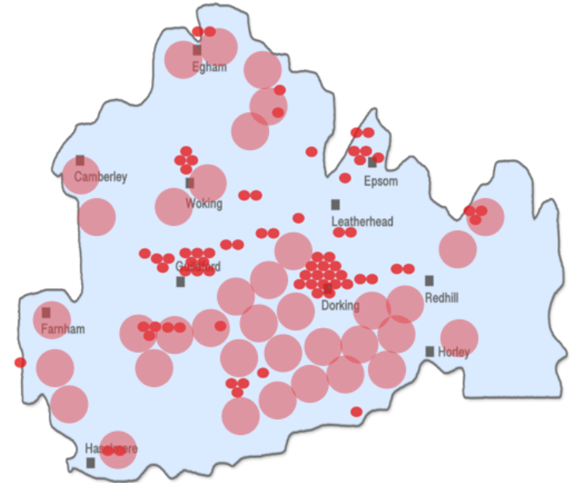
Supporting our network to engage residents
  We have a strong network with circa 200 local groups
  We provide advice and information, and support engagement and promotion
  We run a range of events, talks and webinars, and networking activities
  The Surrey Climate e-forum is our main information bank, helping community groups share their knowledge.
  We provide training on climate engagement
In our network we have:
What Next? Waverley Climate Emergency Centre
Woking Environment Action
Incredible Edible Spelthorne
Talking Tree
Circular Dorking
Oxshott Net Zero
Roots for the Future
Healthy Travel Weybridge
XR Godalming
Soroptimist International Woking
Churt Parish Council
and many other groups
Notes:
We provide advice and info. Jacquetta is our network manager and she has very good relationships. People get in contact and she links them to tailored advice, contacts and resources. We have a monthly e-news and a lively e-forum.
This community relationship has lead into specific funded priojects.

Slide 10
App 1
Survey of community groups working for nature and the climate in Surrey

Slide 11
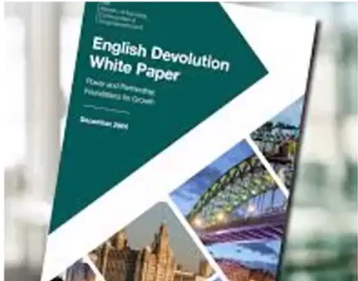
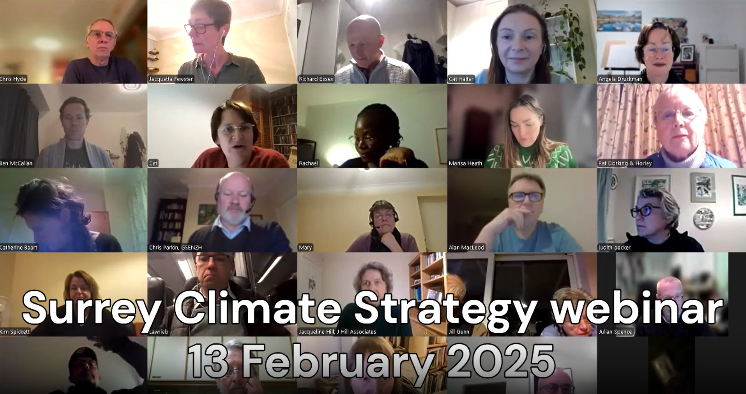
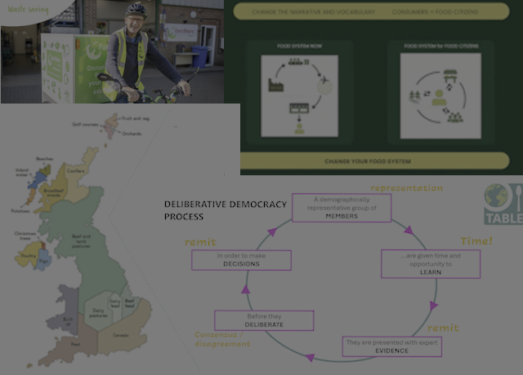



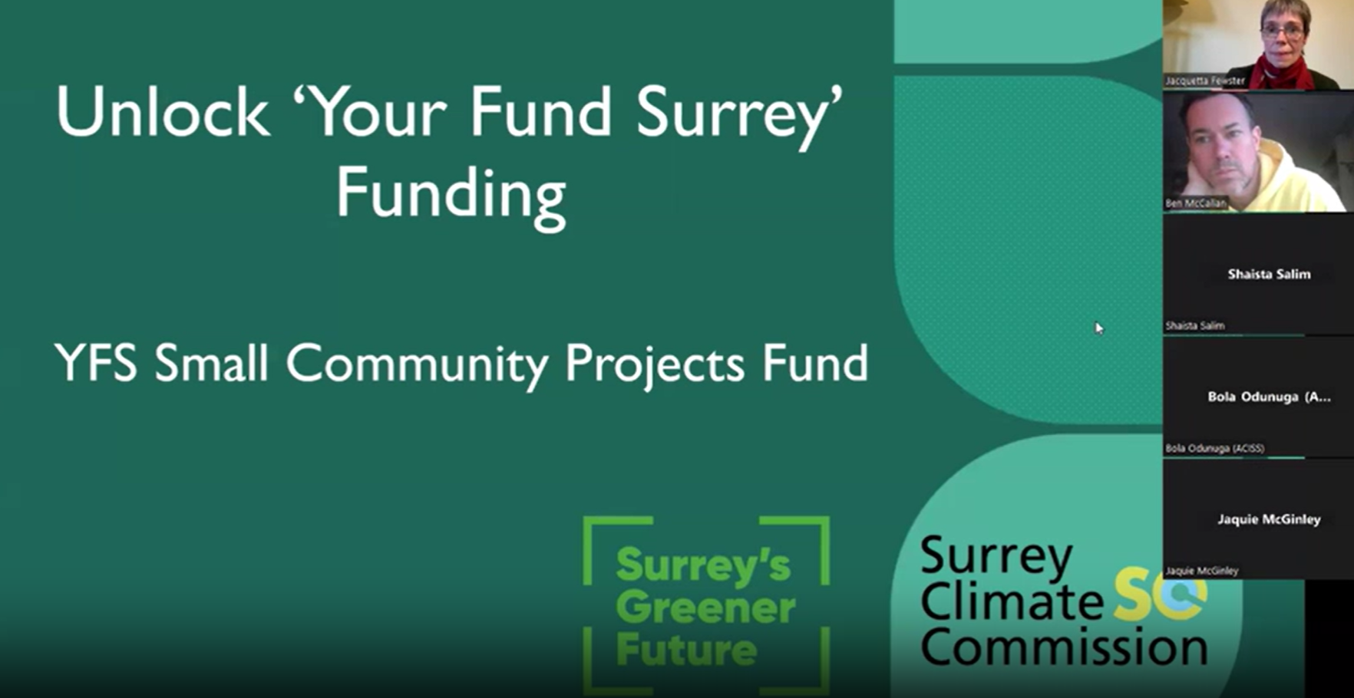


App 2
Webinars
Responding to the needs of the network, the Commission hosted a range of webinars for community groups in 2024-25.

Slide 12
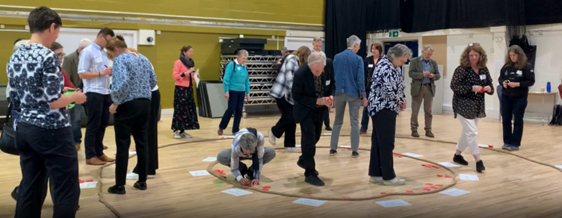
App 3
What’s Stopping Us Stopping Climate Change 2.0: Transforming Surrey into a Home of Thriving People and Nature
The Workshop event was a hugely constructive and creative day with contributions from a wide representation of the community which produced valuable insights. Two clear themes emerged:
1. That too many plans and policies are not co-ordinated and not considered in a holistic manner (too many silos).
2. That not enough of the community are truly engaged in the transformative change that is needed.
Click here for highlights film of event. Thanks to Haeyoung Eun for creating this film.

Slide 13

App 4
Local Energy Advice Demonstrator and HEAT Plus
Funded by UK Power Networks and Surrey County Council
We work closely with Zero Carbon Guildford and partners to provide home energy advice to Surrey residents.
To date (31 March 2025) we have:
- Spoken at 48 local groups and events
- Reached over 630 Surrey residents with advice and information
- Carried out 54 in-depth home visits, of which most are with vulnerable households
- Provided small energy saving measures to over 40 homes
‘I was getting ill because of the cold and would go to the local shops or sit in my car just to keep warm. I am so grateful for the grant and the help; I am not getting ill any more and I actually want to be at home. My home is now a haven.’

Slide 14








Insights from the LEAD focus groups
App 5
46% of households spent over 10% of their income on energy (fuel poverty)
36% had someone unwell or disabled at home (88% for FG4)
21% lived in rented accommodation. 50% for FG1
33% had one or more children under 17 living at home
21% did not have gas heating (50% for FG4)
46% had someone aged 65 + living at home
8% did not speak English at home. 30% for FG2
Notes:
Over 46% thought they spent more than 10% of their income on energy. This was 60% for FG1 - the low income group, and 50% for FG4 - disabled. Interestingly, from the SMEF Ethnic Group 5 participants (45%) also thought they spent more than 10% of their income on energy. This group tended to be well educated working people who owned their own homes, showing that the cost of living crisis has affected everyone.
21% lived in rented accommodation, and this was 50% for the low income group. The challenge of rented homes was a key topic in FG4 (disabled) where we only had a 66% questionnaire return, so the number in rented accommodation may actually be higher.
21% did not have gas heating (i.e. they had either electric or solid fuel), and this was higher (50%) among FG4 (4 people).
8% did not speak English at home. This was 30% for the Ethnic group. Note that FG5 (Shifa) did not complete the questionnaire, and all 9 participants did not speak English at home.
36% had someone unwell or disabled at home (88% for FG4)
33% had at least one child under 17. Note this was 42% before adding in FG4 where there were no children living at home.
46% had someone aged 65 or over.
These stats become more worrying when they are combined, e.g. someone in rented accommodation with young children at home living in fuel poverty, or a disabled owner occupier, without gas heating in fuel poverty.

Slide 15
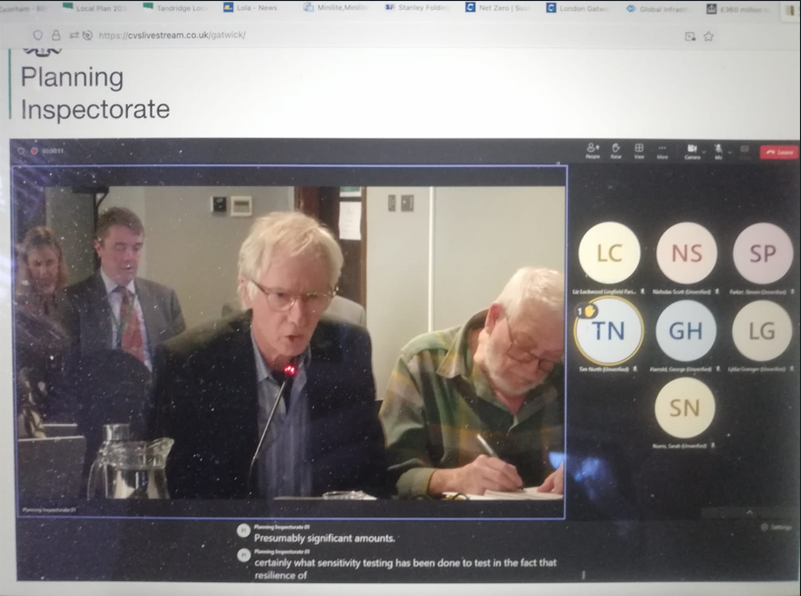
Thought Leadership
App 6
National Integrated Transport Strategy and TfSE Transport Strategy. In February 2025 the Climate Commission provided its responses to a government call for ideas on an Integrated National Transport Strategy and subsequently accepted an invitation to attend a Department for Transport workshop to contribute its views.
In March 2025, the Climate Commission responded to consultation by Transport for the South East on its draft Transport Strategy. We said that decarbonisation and sustainability were not fully reflected in the package of interventions. We objected to the inclusion of highway capacity enhancement schemes and pointed out that these were at odds with TfSE’s decarbonisation priority and the Avoid-Shift-Improve principle. We also noted that climate change adaptation should have been included in the missions.
In 2024, the Commission gave evidence to the hearing into the expansion of Gatwick airport.

Slide 16

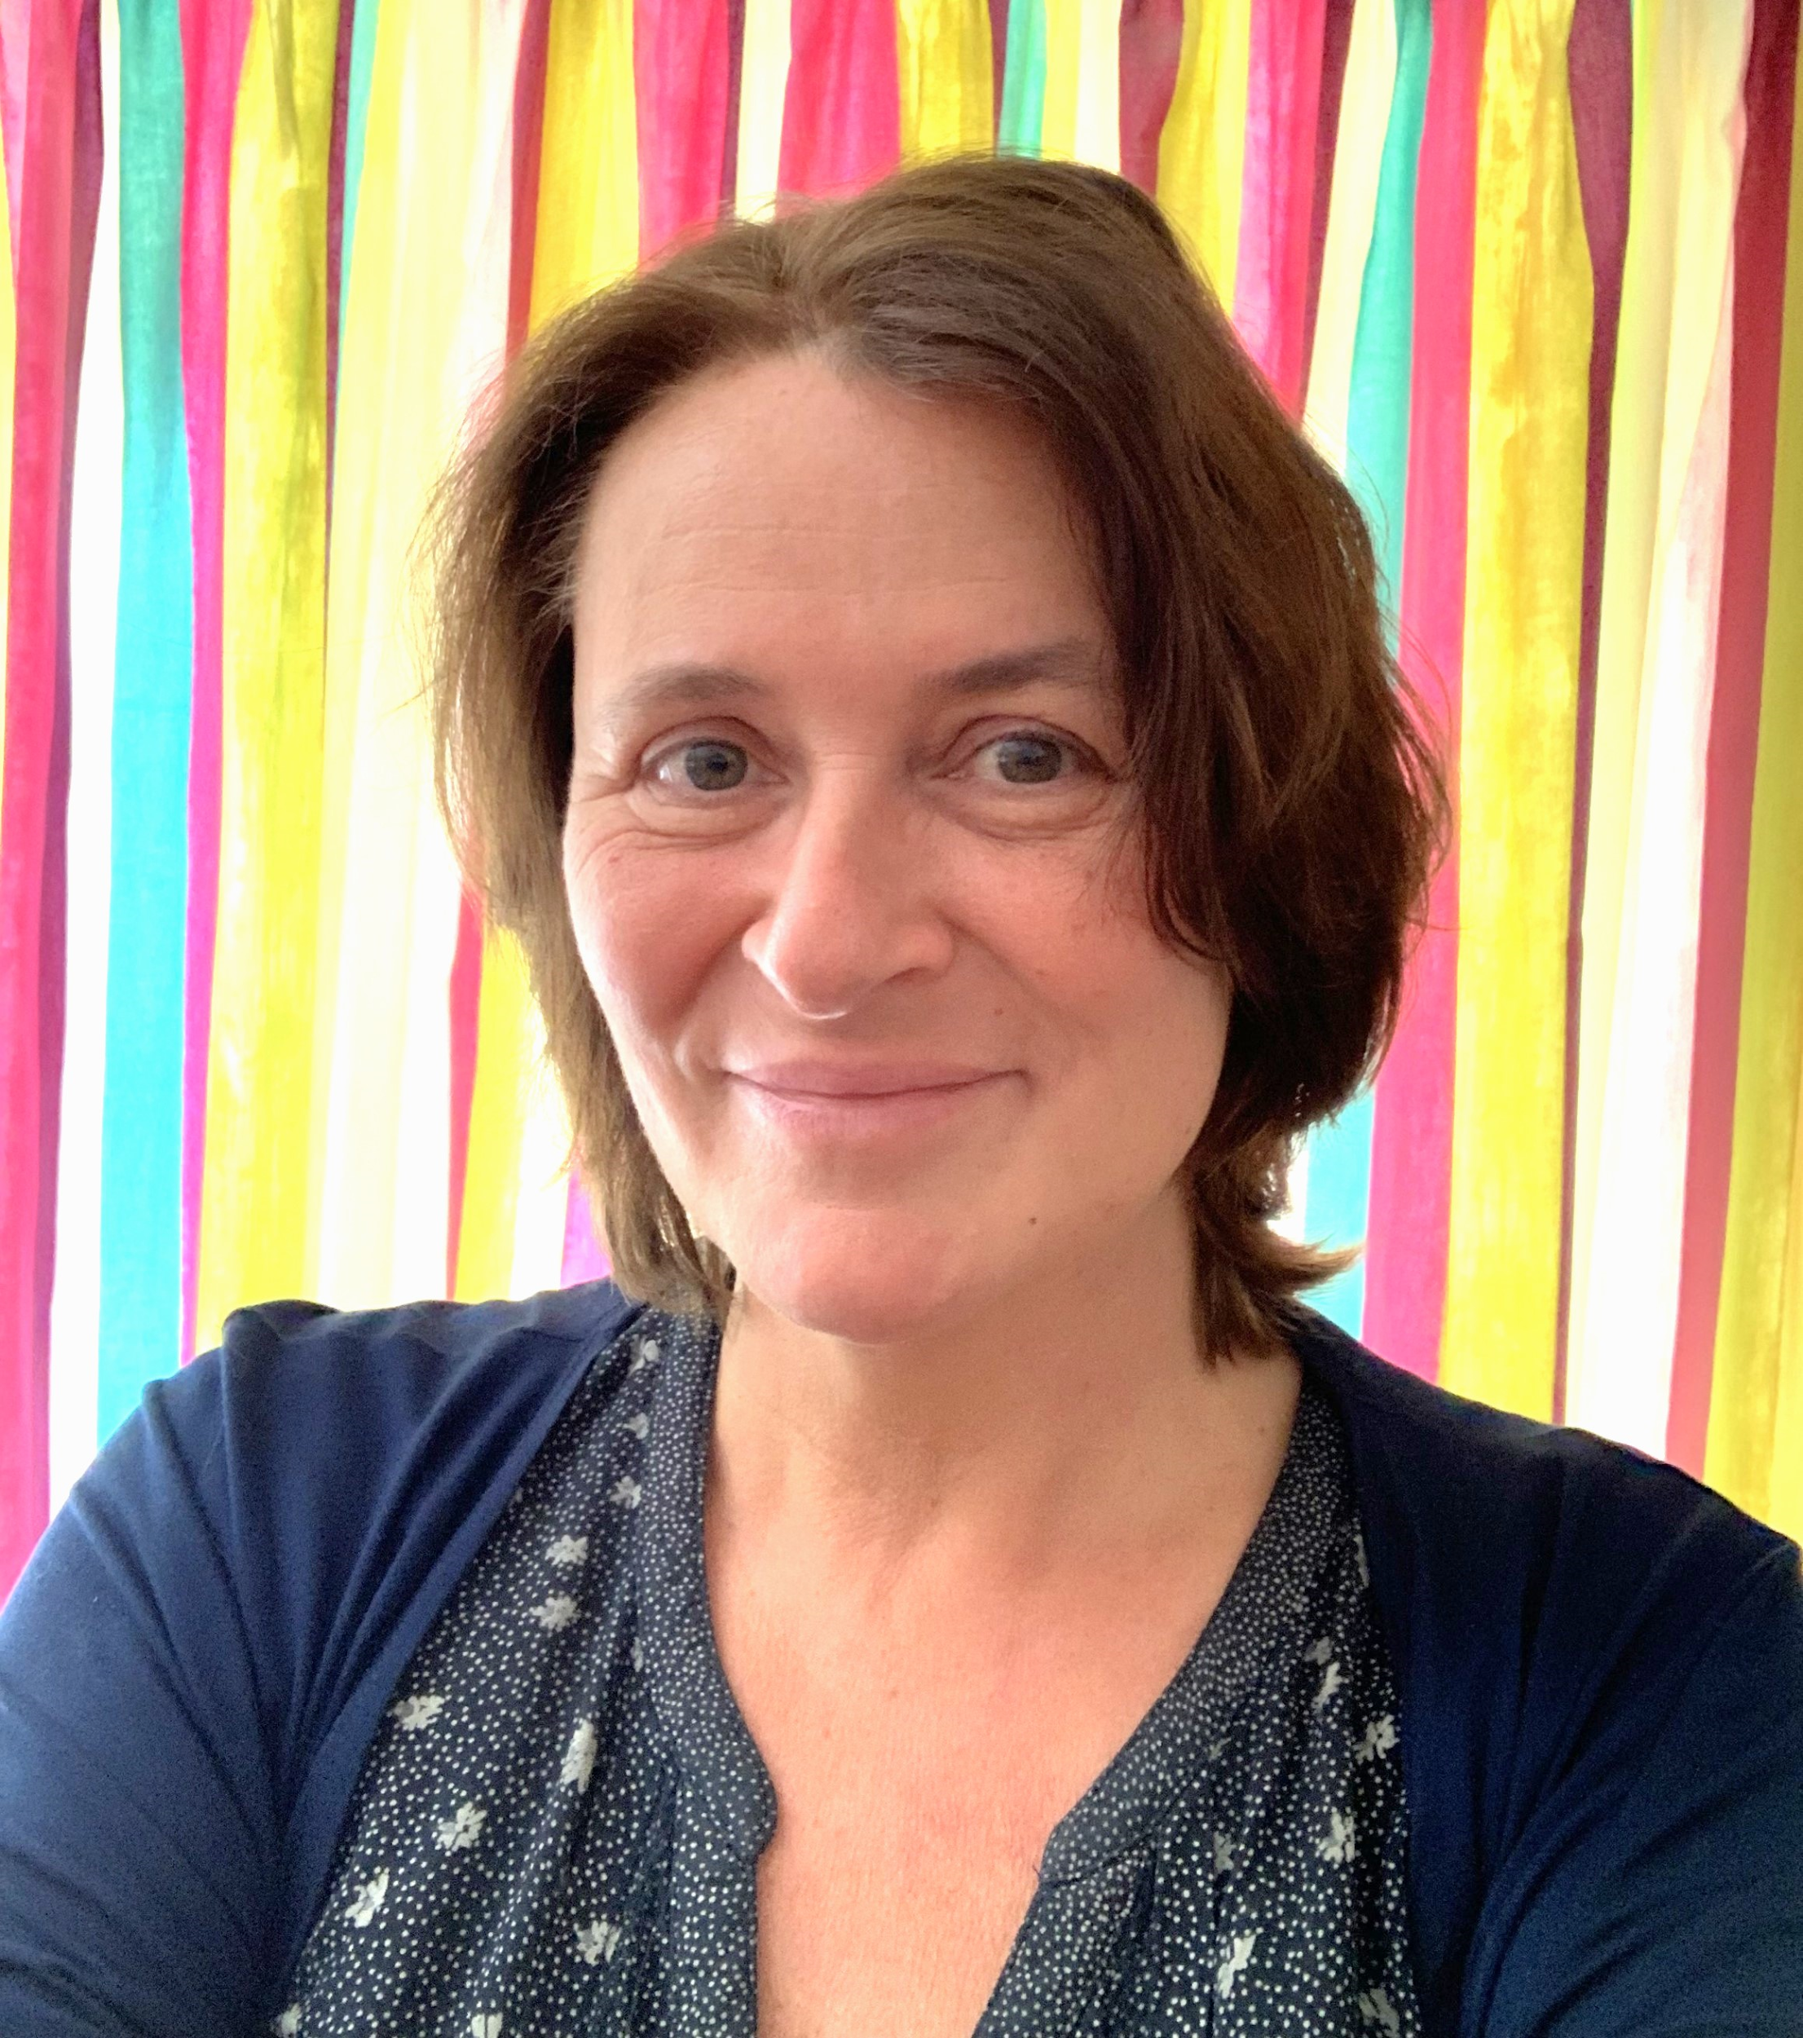
Cat Reeby - Director
Cat Reeby leads on the Commission’s projects
BEng Mechanical Engineering, MSc Energy & Environmental Management
25 years’ experience in the energy sector
Founder and Chair of Surrey Energy Partnership

Slide 17
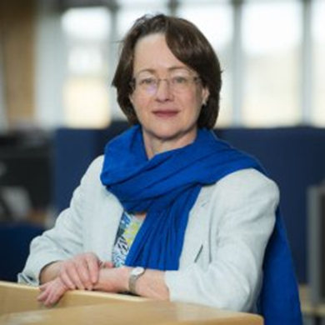
Angela Druckman Director
Angela is Emerita Professor of Sustainable Consumption & Production at the University of Surrey.
Through her teaching, research and advisory roles, Angela aims to drive widescale systemic change, to enable everyone to live well now and into the future, within the Earth’s ecological limits.
Angela is on Surrey’s Greener Futures Board; North Star Transition's Advisory Board; and is also carrying out advisory work for Circular Communities Scotland .
Her multidisciplinary research investigates avenues towards more sustainable lifestyles, taking a holistic, systems-based approach that encompasses supply chain analysis combined with understandings of individual and societal behaviours.

Slide 18
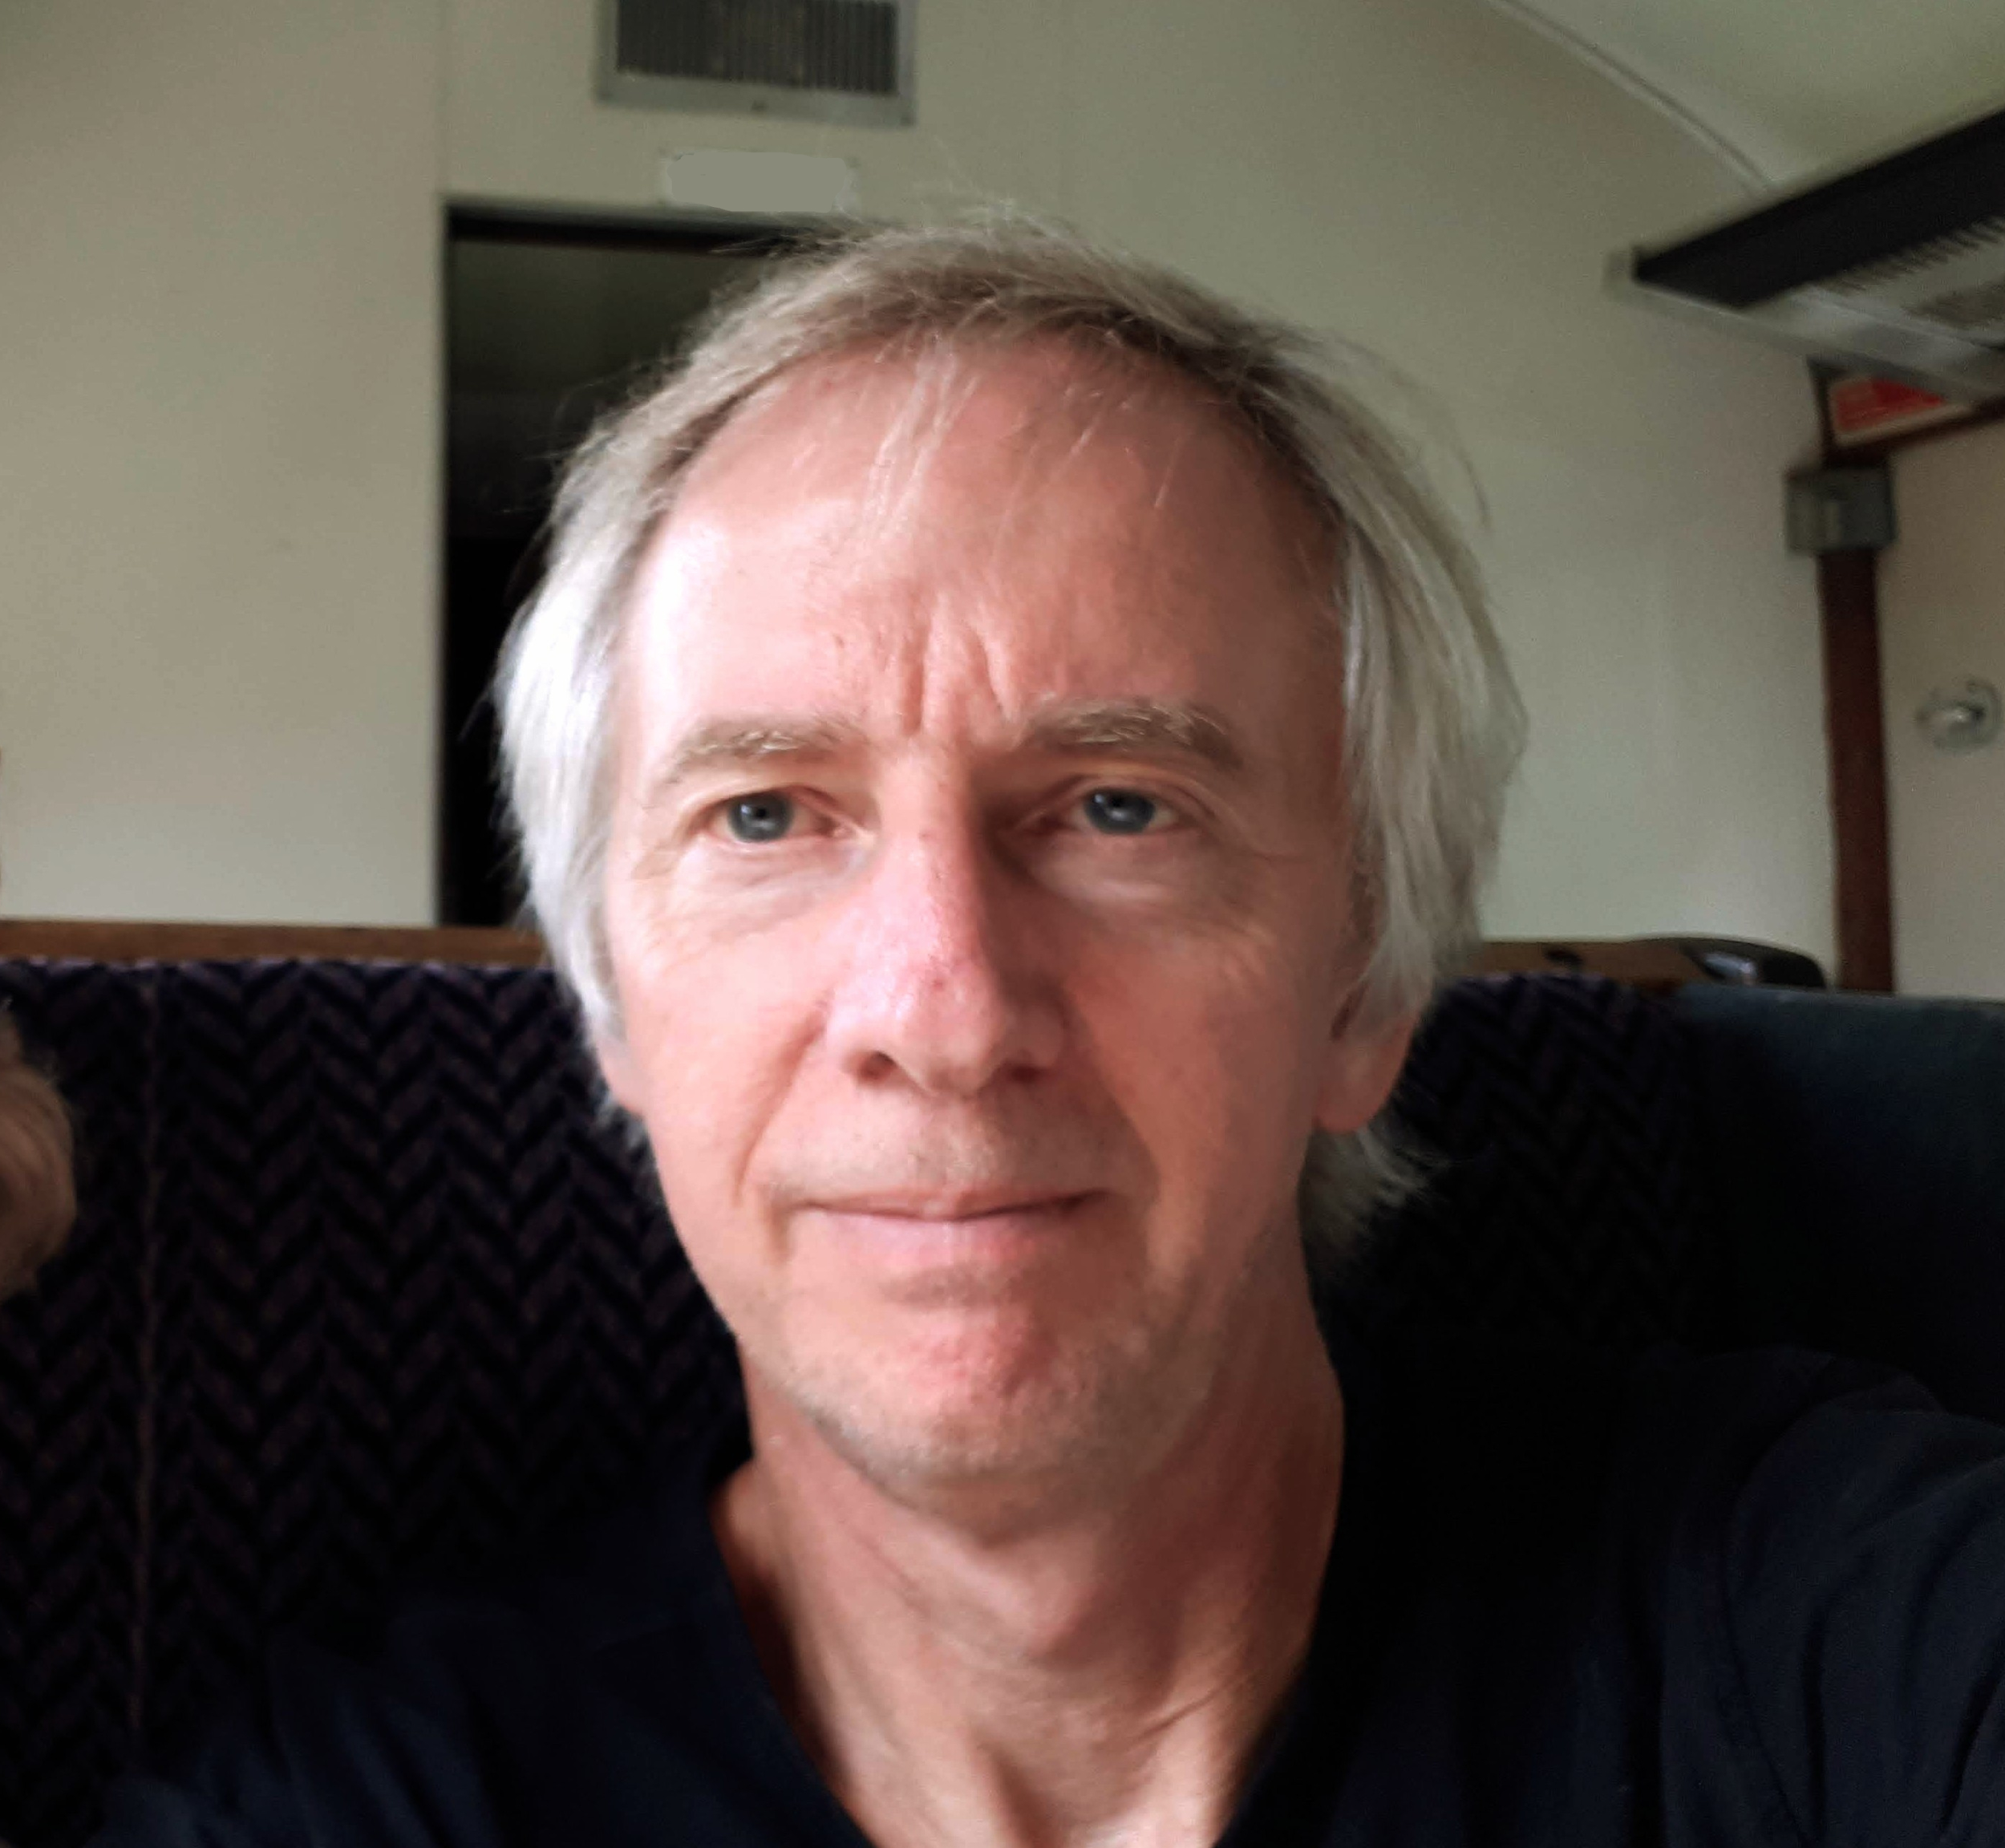
Chris Hyde Director
Chris’s background is as a transport planner, providing research, teaching, and consultancy, for London Transport , the Greater London Authority and as a senior manager at Transport for London.
Chris was on the team that produced Mayor Ken Livingstone’s first transport strategy, contributed to planning the Elizabeth Line, and helped develop the first cycle strategy for London.
He has represented London on a European transport group, contributed to setting up GLA Economics, and under Mayor Boris Johnson led the transport team that successfully challenged a third runway at Heathrow.
He is also one of the founders and a Director of the Talking Tree Climate Emergency Centre in Staines.

Slide 19
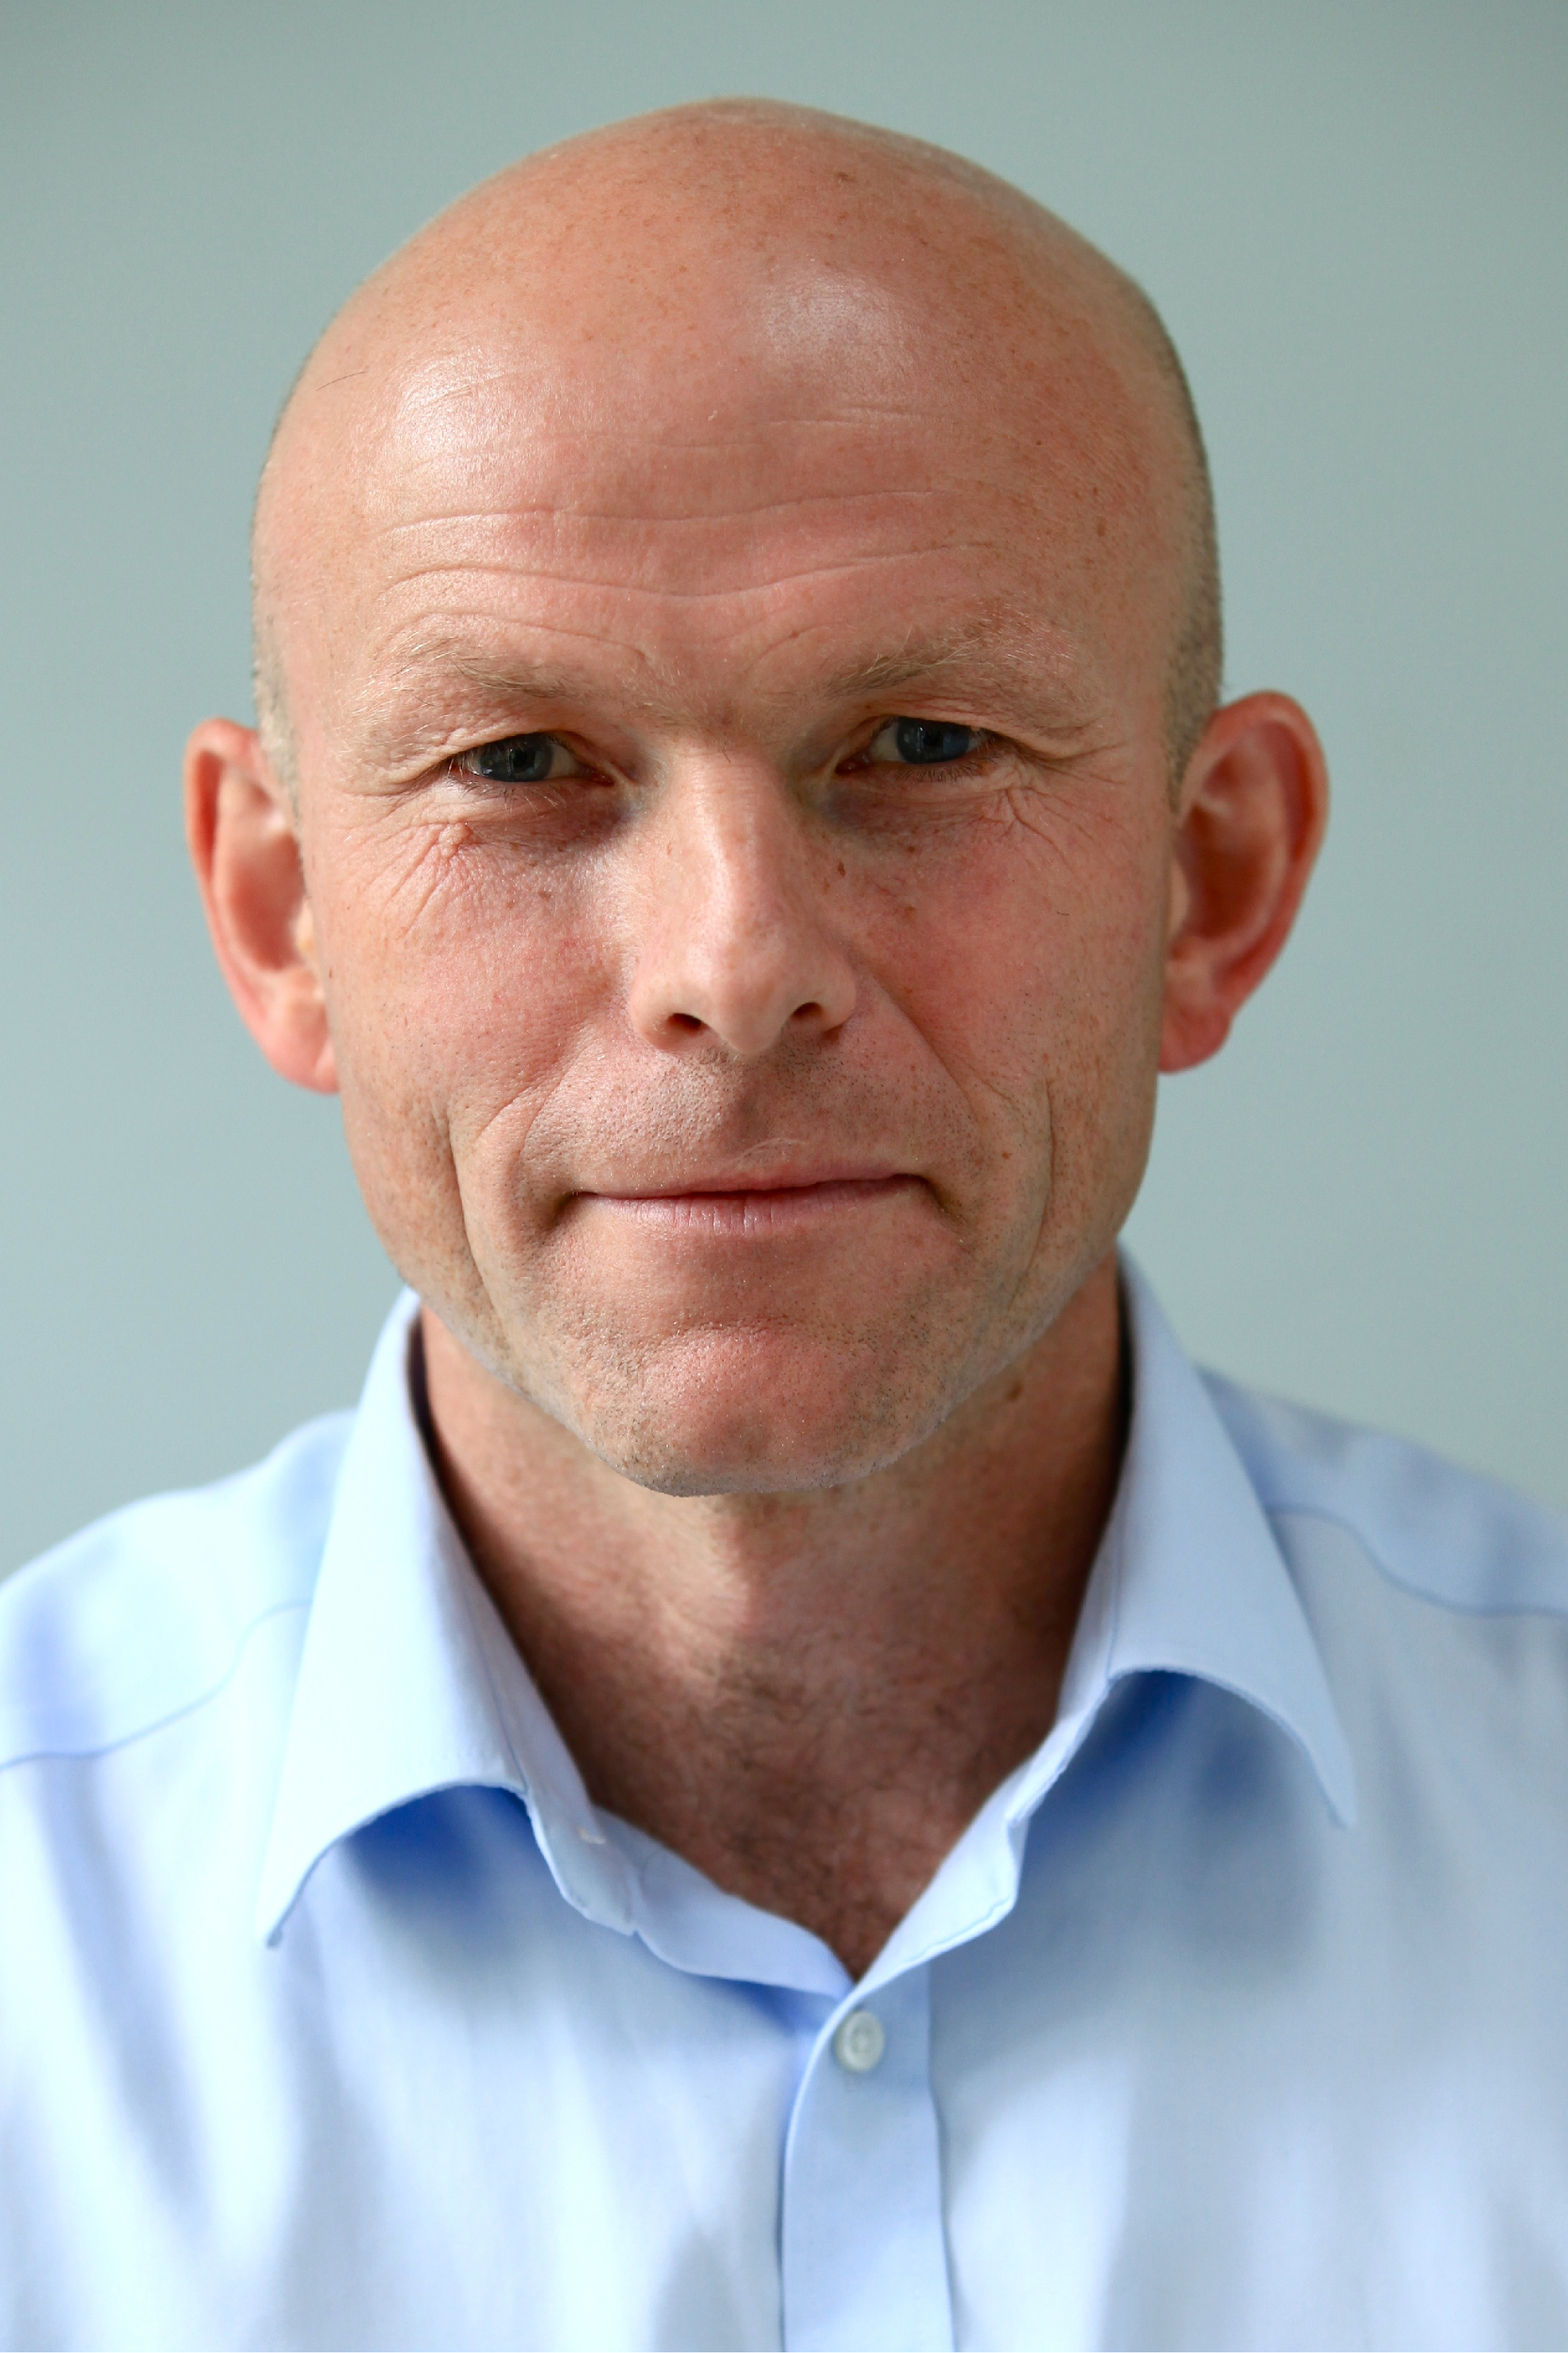
Richard Essex Chair and Director
Richard is Chair of the Surrey Climate Commission, which he helped to initiate back in 2019.
He also sits on Surrey’s Greener Future Board and is a council member of Surrey Chambers of Commerce.
In his other time Richard is an Independent Financial Adviser. specialising in sustainable and responsible investment.
He has been at the forefront of promoting sustainable investing and is author of ‘Invest Feelgood Make a Difference’, published in 2014.

