Slide 1

Carbon Baselining - County of Surrey
Update prepared for the Surrey Climate Commission
by
Erica Russell with Ian Christie and
Richard Murphy
University of Surrey
June 2020

Slide 2
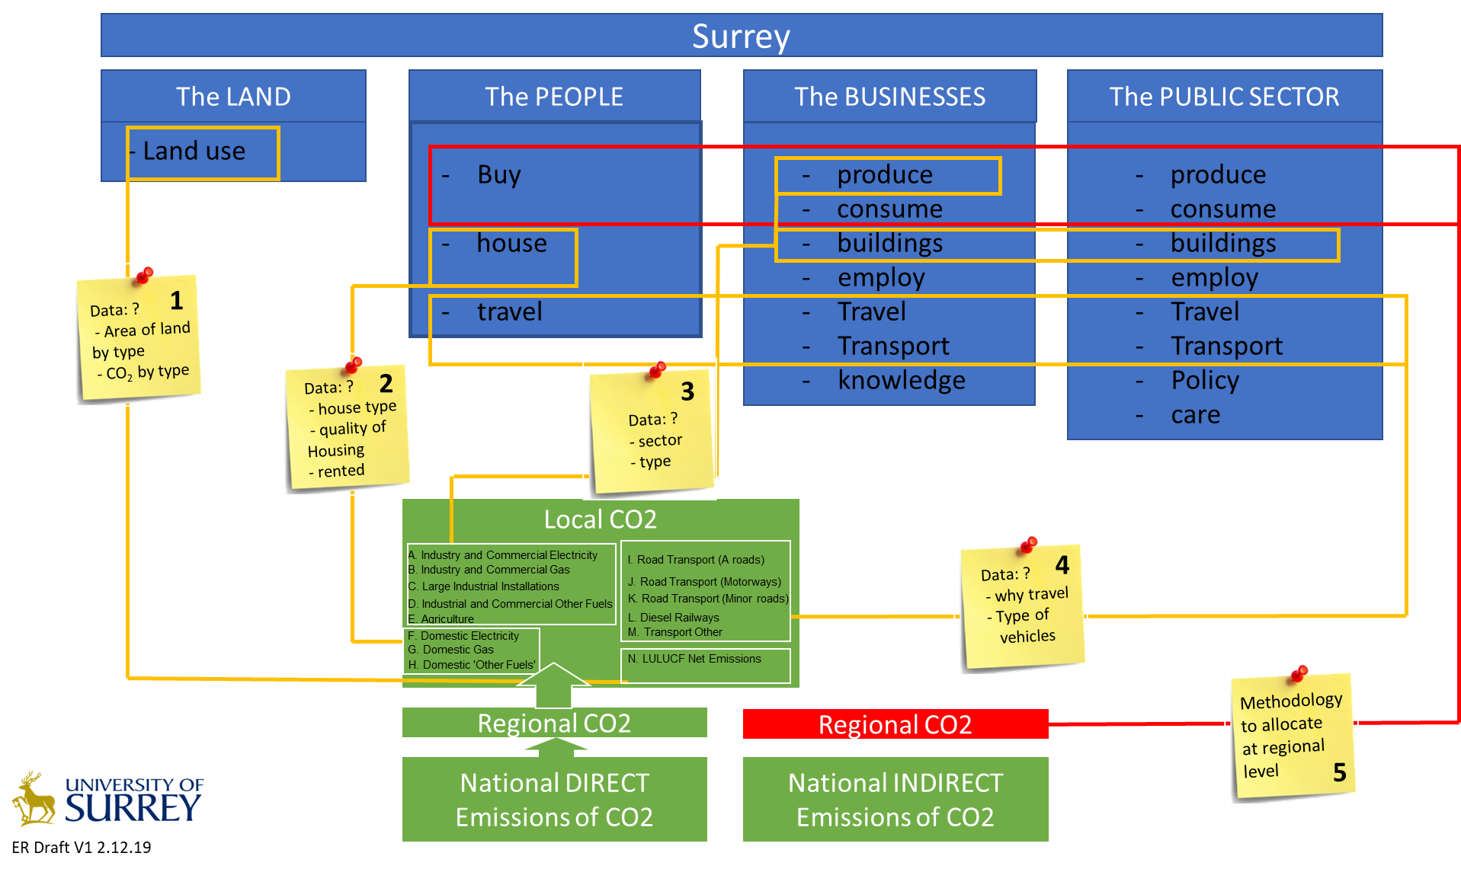
Data Collection Strategy

Slide 3
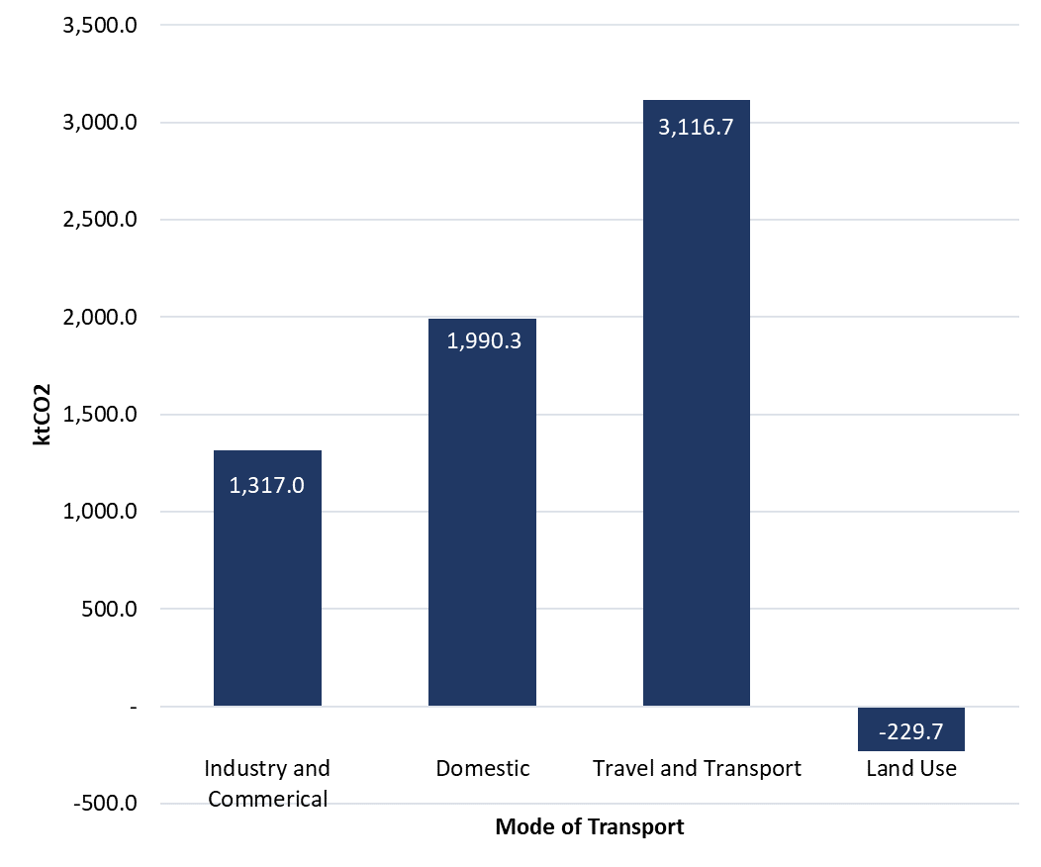
Source of carbon emissions Surrey, 2017 (ktCO₂)
Surrey: 6194.3 ktCO₂/annum
Source: ONS Local Authority CO₂ emissions estimates 2017 (kt CO₂)

Slide 4
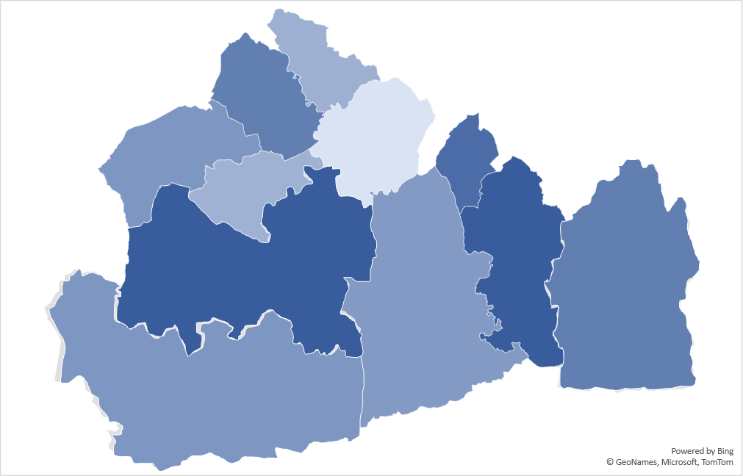
ONS Local Authority CO₂ emissions estimates 2017 (ktCO₂)
Surrey: 6194.3 ktCO₂/annum
Spelthorne
Runnymede
7%
10%
Elmbridge
Epsom & Ewell
Surrey Heath
4%
9%
11%
Reigate & Banstead
7%
Woking
12%
Guildford
8%
13%
10%
Tandridge District
Waverley
9%
Mole Valley
Source: University of Surrey, based on 2011 Census data and using DEFRA 2019 CO₂ conversion factors for business-travel and freight.

Slide 5
UK's Carbon Footprint
Data presented is based on greenhouse gas emissions associated with UK consumption 2017, DEFRA/ONS
Imports used by UK business for UK consumption and directly by UK consumers
45%
UK production emissions attributable to UK final consumption
35%
INDIRECT OR EMBODIED
EMISSIONS
9%
10%
Road transport emissions generated directly by households
Households heating emissions arising from use of fossil fuels
DIRECT EMISSIONS
Visualisation: University of Surrey

Slide 6
Aligning strategy and workstreams
Surrey County Council | TRANSPORT AND AIR QUALITY | ENERGY GENERATION | BUILDINGS AND INFRASTRUCTURE | HOUSING AND PLANNING | LAND USE AND FOOD SYSTEMS | WASTE, RESOURCES AND CIRCULAR ECONOMY | INDUSTRY AND GREEN ECONOMY
Surrey Climate Commission Working Groups | Transport | Energy and Built Environment |  | Planning Strategy and Land Use
 | Community and Engagement
 | Community and Engagement
Baseline data | Direct Emissions: Commuting, General transport | Direct Emissions: Some renewable data from LA | Direct Emissions from housing by size/type of property, Public sector buildings and use | Direct Emissions from housing by size/type of property, | LUCLUF data | Not covered | Direct emissions, Sub set, key emitters and Business parks | Consumption based footprint
Visualisation: University of Surrey

Slide 7
Direct Emissions

Slide 8
Transport: Source of carbon emissions Surrey, 2017 (ktCO₂)
3,116.7 ktCO₂/annum
TRANSPORT AND AIR QUALITY
Note: transport describes ‘traffic’ movements – not just the transport of goods (NAEI, June 2019,Technical Report)
Source: ONS, Local Authority CO₂ emissions estimates 2017 (kt CO₂)

Slide 9
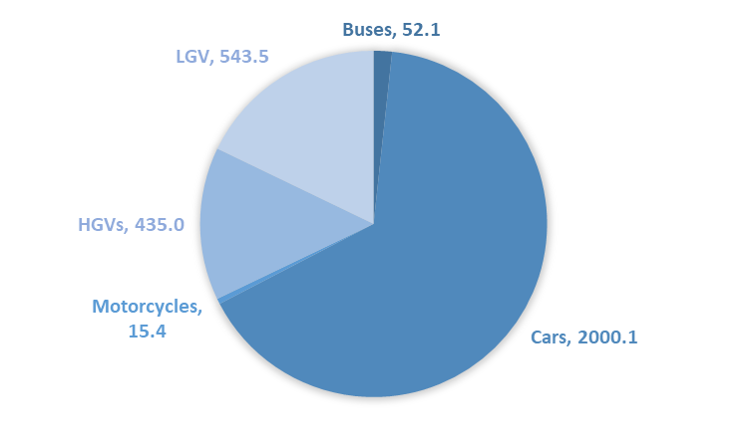
Transport: Estimated source of Surrey CO₂ road emissions 2017
Allocation of total emissions, Surrey road usage 2018 (KtCO₂)
3046.1 ktCO₂/annum
TRANSPORT AND AIR QUALITY
Source: University of Surrey, based on ONS (2017), BEIS (2015), BEIS (2019) and DUKES (2019)

Slide 10
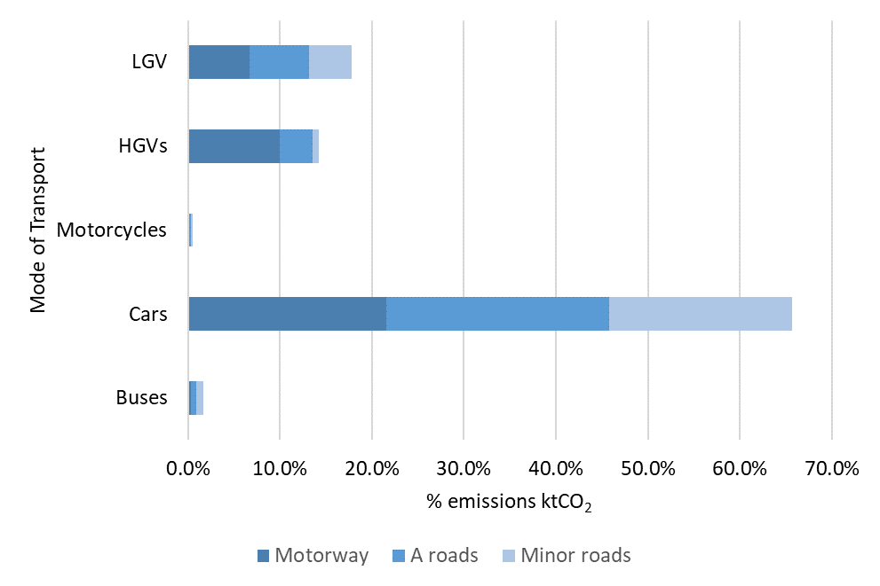
Transport: Estimated source of Surrey CO2 road emissions 2017 (ktCO₂)
TRANSPORT AND AIR QUALITY
Data available by District by ktCO₂, but underestimation due to conversion factors
Source: University of Surrey, based on ONS (2017), BEIS (2015), BEIS (2019) and DUKES (2019)

Slide 11
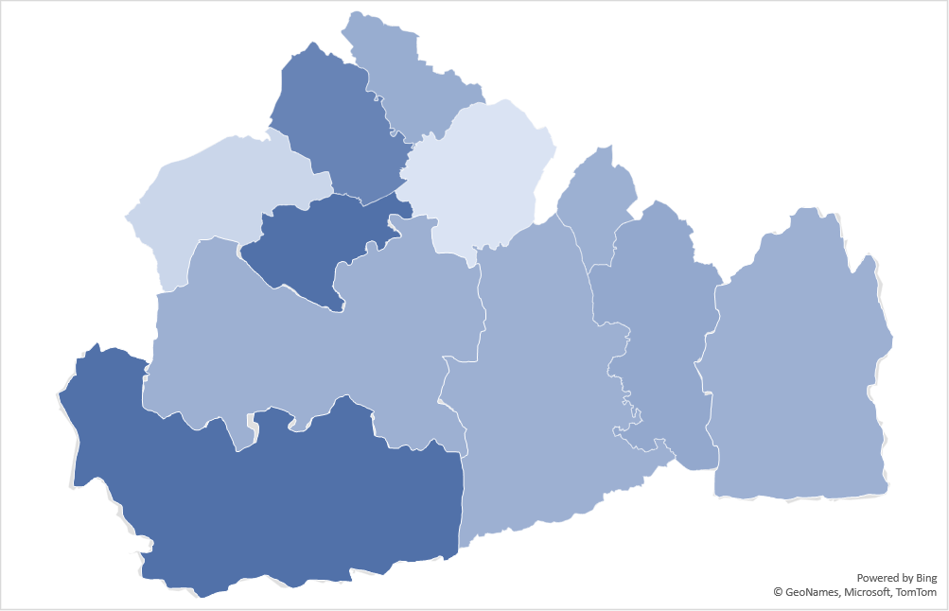
Emissions created by Surrey residents travelling to work (% ktCO₂ /annum)
Spelthorne
174.1 ktCO₂/annum
Runnymede
8.2%
TRANSPORT AND AIR QUALITY
11.6%
Elmbridge
Epsom & Ewell
Surrey Heath
3.6%
4.8%
8%
Reigate & Banstead
13.3%
Woking
8.6%
Guildford
7.9%
8.8%
9.5%
Tandridge District
Waverley
15.6%
Mole Valley
Source: University of Surrey, based on 2011 Census data and using DEFRA 2019 CO₂ conversion factors for business-travel and freight.

Slide 12
Travelling to work by Sector (% ktCO2 /annum)
TRANSPORT AND AIR QUALITY
Source, University of Surrey, based on 2011 Census data and using DEFRA 2019 CO₂ conversion factors for business-travel and freight.

Slide 13
Surrey Residents Travel to work: Data Analysis
TRANSPORT AND AIR QUALITY
Source: University of Surrey, based on 2011 Census data and using DEFRA 2019 CO₂ conversion factors for business-travel and freight.

Slide 14
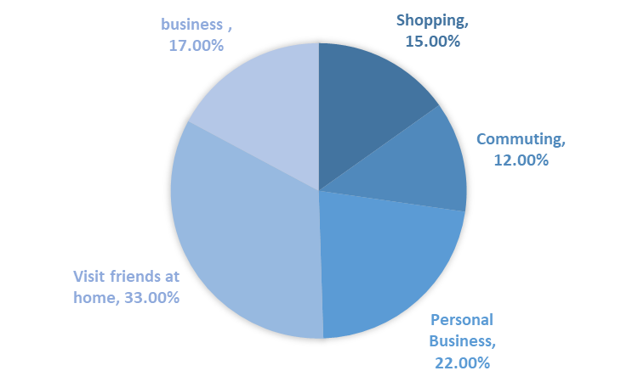
Surrey Residents Travelling
Research by DfT identifies why people undertake journeys – the % provided in this slide indicate why, at a national level, people travel.
If this is applied to Surrey, and using the estimate of 174ktCO₂ for commuting, a figure of 1435ktCO₂ is derived.
This is a crude measure. It does not allow for journeys outside the county, mode of travel and does not reflect affluence effects.
1435.5 ktCO₂/annum
Source: University of Surrey, based on DfT (2019), National Travel Survey:England 2018; 2011 Census data and using DEFRA 2019 CO₂ conversion factors for business-travel and freight.

Slide 15
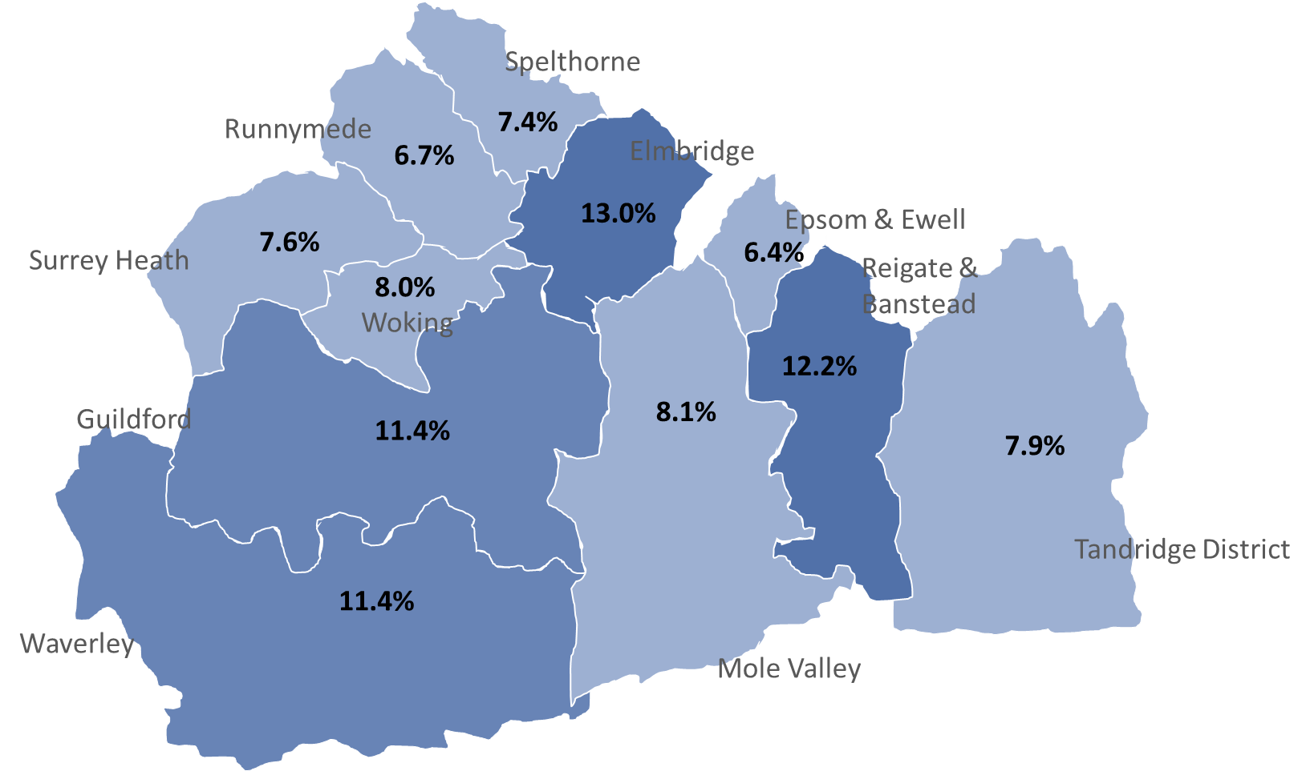
Percentage of domestic carbon emissions by Surrey District, 2017
Surrey: 1990.3 ktCO₂/annum
BUILDINGS AND INFRASTRUCURE
HOUSING AND PLANNING
Source: ONS Local Authority CO₂ emissions estimates 2017 (kt CO₂)

Slide 16
Estimated emissions from Housing by type– 2019
Surrey District | Total C02 emissions/ annum for houses and bungalows based on EPC data 2019 | Total C02 emissions/ annum for flats/maisonettes based on EPC data 2019 | Total C02 emissions/ annum for mobile homes based on EPC data 2019 | Total C02 emissions/ annum based on EPC data 2019 |  | Local Authority CO2 emissions estimates 2017 (kt CO2) - ONS
Elmbridge | 239.3 | 33.0 | 0.0 | 272.3 |  | 257.8
Epsom and Ewell | 116.7 | 17.8 | 0.0 | 134.5 |  | 126.5
Guildford | 194.3 | 24.3 | 1.9 | 220.5 |  | 227.5
Mole Valley | 158.0 | 18.6 | 2.1 | 178.7 |  | 162.2
Reigate and Banstead | 183.3 | 29.5 | 1.6 | 214.5 |  | 242.7
Runnymede | 115.1 | 16.0 | 2.2 | 133.2 |  | 132.5
Spelthorne | 129.2 | 22.3 | 1.2 | 152.6 |  | 147.2
Surrey Heath | 143.3 | 12.0 | 1.0 | 156.3 |  | 150.9
Tandridge | 148.7 | 18.5 | 1.0 | 168.2 |  | 157.8
Waverley | 222.9 | 21.7 | 0.0 | 244.6 |  | 226.4
Woking | 129.6 | 23.4 | 0.0 | 153.0 |  | 158.8
Total |  |  |  | 2028.3 |  | 1990.3
BUILDINGS AND INFRASTRUCURE
HOUSING AND PLANNING
Source: University of Surrey based on ONS, Accommodation by local Authority – Census 2011 and EPC data 2019

Slide 17


Public Sector – gaps in data, variable formats and emissions reporting and incomplete data
BUILDINGS AND INFRASTRUCURE
Source: University of Surrey based on NHS data 2017, Council websites, care home lists, and other materials
Notes:
ONS – 2018 Public sector just under 2% of all emissions nationally (2018 UK Greenhouse Gas Emissions, Final figures 4 February 2020 National Statistics
Mole Valley and Elmbridge are working with the Carbon Trust on mapping emissions 1-3
No data for Spelthorne, Surrey Heath, Tandridge – data used is average of Elmbridge, Epsom, Mole Valley and Runnymede

Slide 18
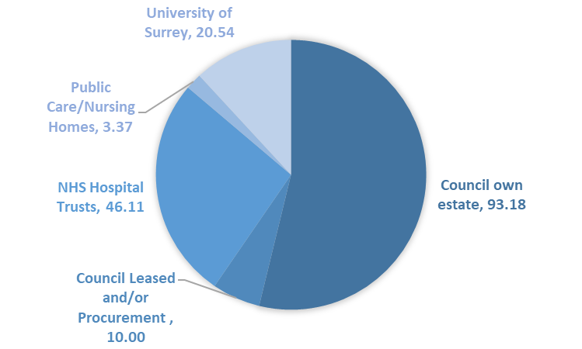
Estimated emissions from the public estate– 2012-2018 (ktCO₂e)
Surrey: 131.5 ktCO₂/annum*
*Notes:
District CO2 emissions incomplete
Public sector recording both CO2 and CO2e
Information on leased estate for councils limited
Some procurement data included
Allocation of CO2 emissions to care homes has high
Level of uncertainty – few studies available
BUILDINGS AND INFRASTRUCURE
Source: University of Surrey based on NHS data 2017, Council websites, care home lists, and other materials

Slide 19
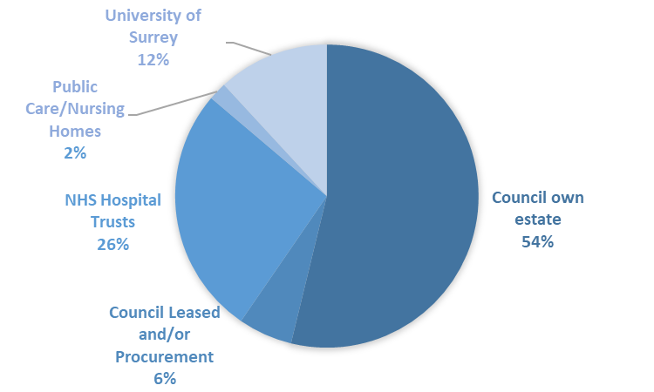
Percentage emissions from the public estate– 2012-2018 (ktCO₂e)
Note issues of partial data
Source: University of Surrey based on NHS data 2017, Council websites, care home lists, and other materials

Slide 20
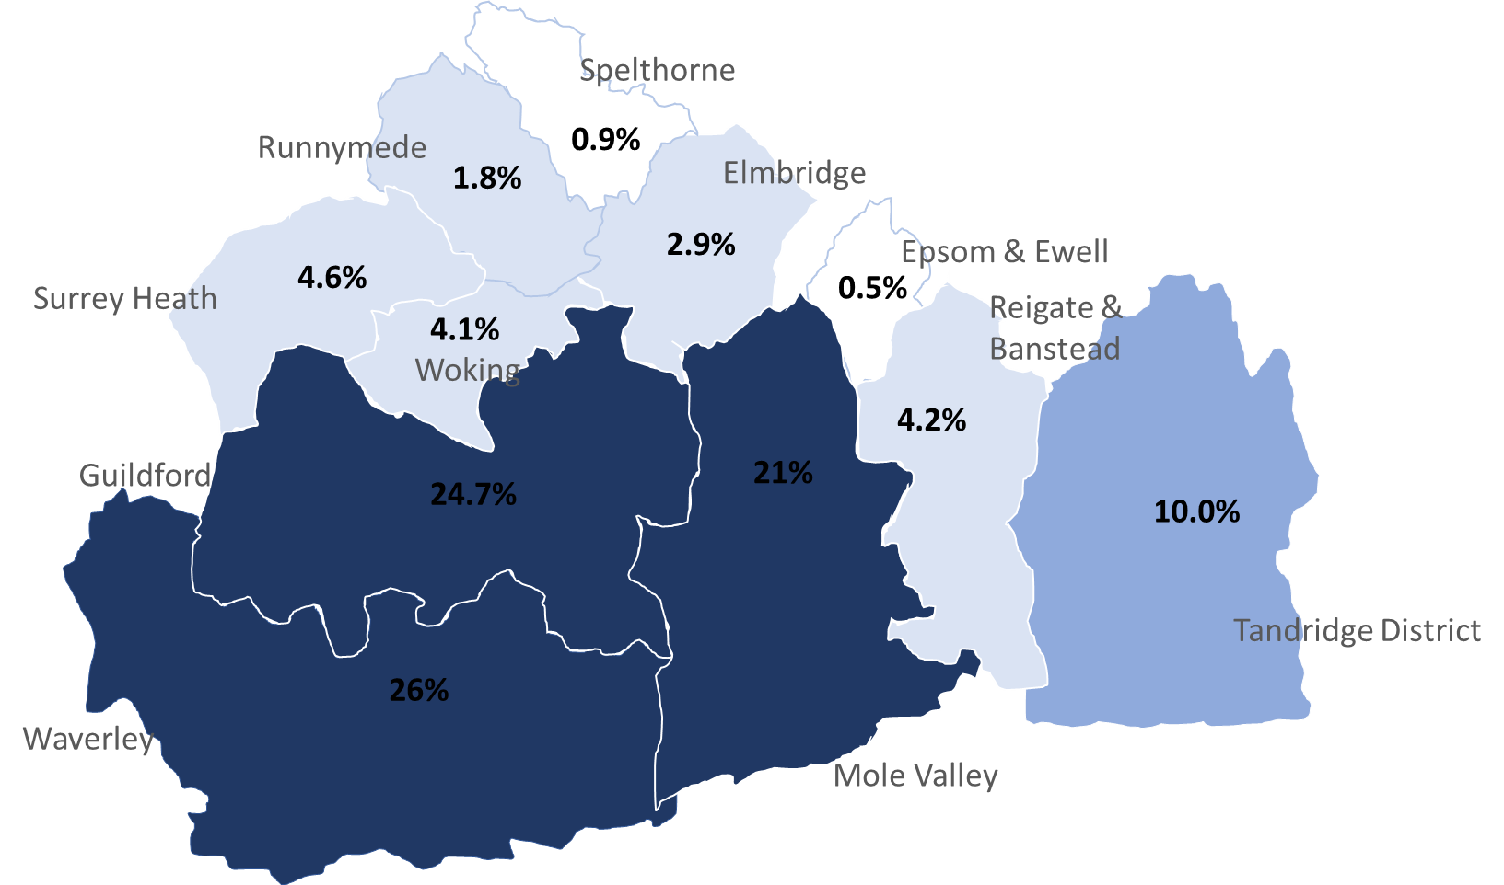
% ktCO2 emissions capture by District, ONS 2017
-229.7 ktCO₂/annum
LAND USE AND FOOD SYSTEMS

Slide 21
Land Use by District, ONS 2017 and CORINE, 2018
LAND USE AND FOOD SYSTEMS
Work still ongoing to establish best methodology to calculate CO₂ emissions/sequestration by land type by District to allow scenarios to be undertaken.

Slide 22
DISCUSSION RICHARD/ER
More detailed allocation of agricutural land types - CORINE project -
 | Data Provided as % land use
 |  |  |  |  | Sub Set- Agriculture and Woodland/water/open land
 |  | Area (km²) |  |  | Arable | Berries and Fruit | Pasture | Other Agriculture | Broadleaf Forest | Coniferous forest | Mixed Woodland | Heath | Scrub | Water
 |  |  |  |  | % | % | % | % | % | % | % | % | % | %
 | Local authority
 | Elmbridge | 96.30 |  |  | 6.6 |  | 12.7 |  | 10.5 | 1.8 | 1.3 |  |  | 2.4
 | Epsom and Ewell | 34.07 |  |  | 2.96 |  | 13.4 |  | 6.9
 | Guildford | 270.9 |  |  | 16.1 |  | 34.8 |  | 15.1 | 6.3 | 2.4 | 4.2 | 0.5
 | Mole Valley | 258.3 |  |  | 18.5 |  | 43.1 |  | 16.7 | 1.5 | 3.6
 | Reigate and Banstead | 129.1 |  |  | 20.0 |  | 31.6 | 1.7 | 7.1 |  | 1.4
 | Runnymede | 78.0 |  |  | 1.3 |  | 28.6 |  | 15.9 | 0.7 | 2.6 |  |  | 2.0
 | Spelthorne | 51.2 |  |  | 2.3 |  | 14.6 | 5.1 |  |  |  |  |  | 18.5
 | Surrey Heath | 95.1 |  |  | 0.7 |  | 22.1 | 0.7 | 10.3 | 11.2 | 0.8 | 15.3
 | Tandridge | 248.2 |  |  | 25.5 |  | 45.9 | 1.3 | 9.7 |  | 0.9
 | Waverley | 345.2 |  |  | 9.4 | 0.8 | 38.5 |  | 14.2 | 4.1 | 13.0 | 3.6
 | Woking | 63.5 |  |  | 29.5 |  |  |  | 9.9 | 2.1 | 1.5 | 0.6
LAND USE AND FOOD SYSTEMS

Slide 23
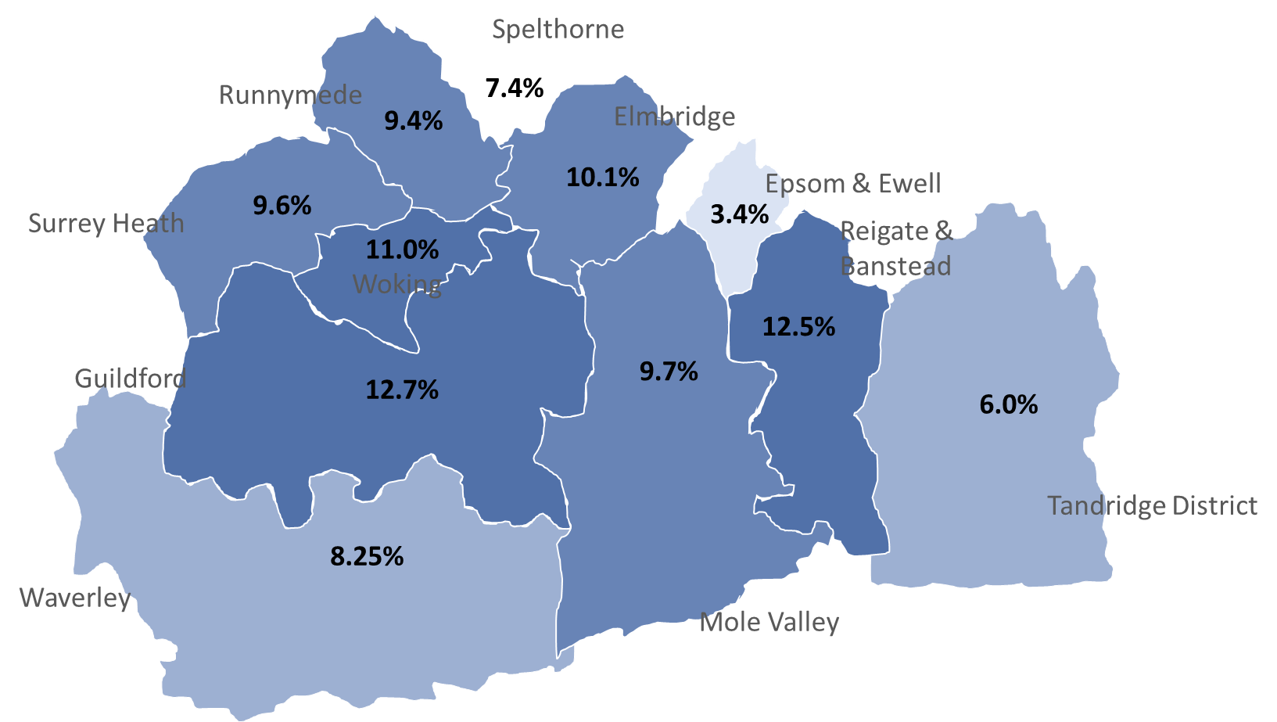
Industry and Commercial in Surrey – Percentage CO₂ emissions by District
Industry and commercial includes
Public sector, defence, social service,
Other services, and
undifferentiated goods and services-producing activities of households for own use
1317 ktCO₂/annum
BUSINESS AND GREEN ECONOMY
Source: ONS, Local Authority CO₂ emissions estimates 2017 (kt CO₂)

Slide 24
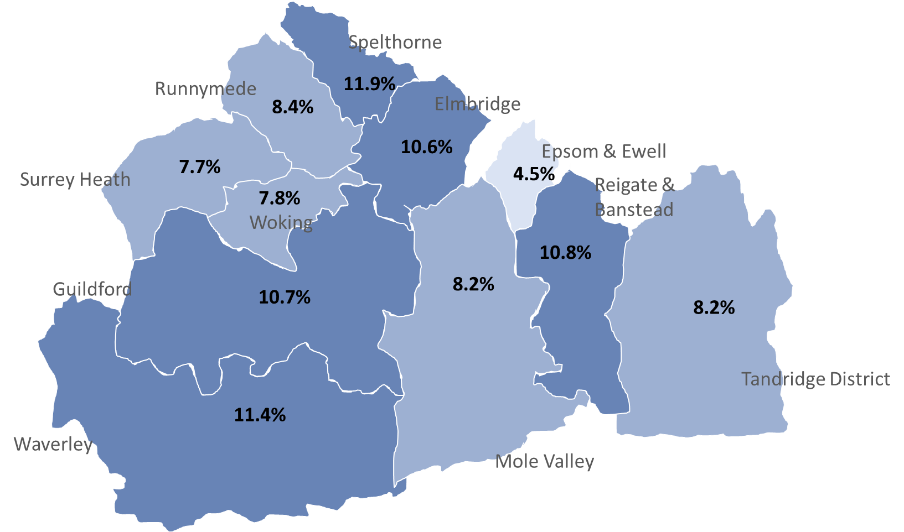
Industry and Commercial in Surrey – Percentage CO₂ emissions by District
Agriculture, forestry and fishing
Manufacturing
Construction
Wholesale and retail trade; repair of motor vehicles and motorcycles
Transport and storage
Accommodation and food services
Information and communication
Financial and insurance activities
Real estate activities
Professional, scientific and technical activities
Administrative and support service activities
Education
Human health and social work activities
Arts, entertainment and recreation
BUSINESS AND GREEN ECONOMY
Source: University of Surrey – allocation of national data by Surrey business number and type - ONS, 2019. Atmospheric emissions: greenhouse gases by industry and gas: Total greenhouse gas emissions by industry section, 1990 to 2017 and (provisional) 2018, accessed 29.1.2020 and ONS, 2019. Number of Businesses in Surrey, accessed 29.1.2020, https://www.surreyi.gov.uk/dataset/24jw6/number-of-businesses-in-surrey

Slide 25
Large Scale private company emitters (ktCO₂, 2017)
BUSINESS AND GREEN ECONOMY
BEIS, National Atmospheric Emissions Inventory, accessed November 2019, https://naei.beis.gov.uk/laco2app/

Slide 26
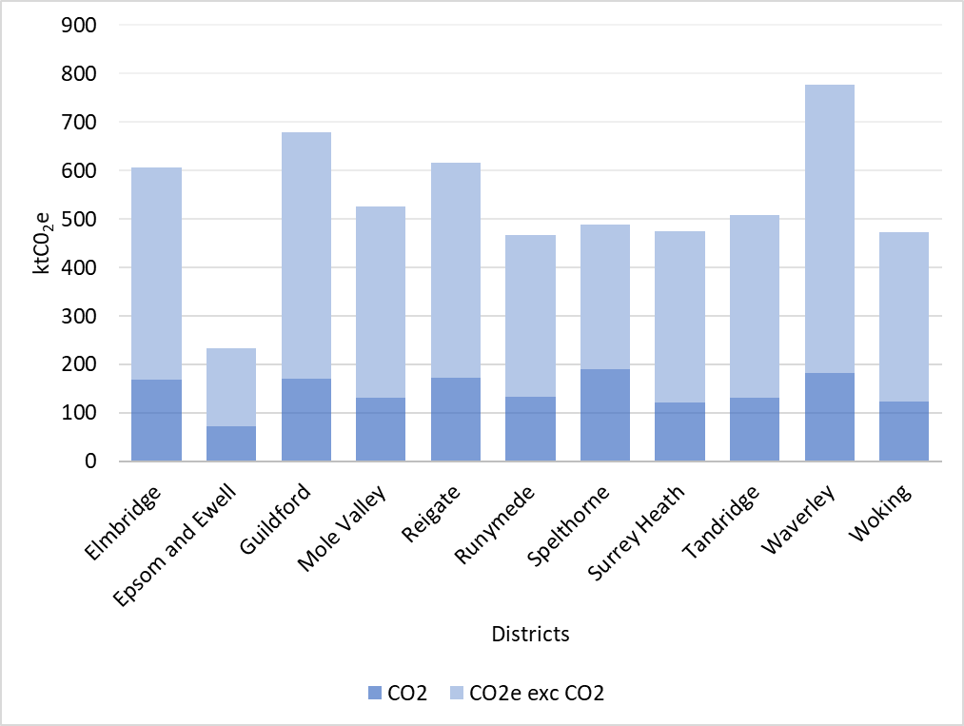
Industry in Surrey – CO₂ and CO₂e emissions – the gap
BUSINESS AND GREEN ECONOMY
Source: University of Surrey – allocation of national data by Surrey business number and type - ONS, 2019. Atmospheric emissions: greenhouse gases by industry and gas: Total greenhouse gas emissions by industry section, 1990 to 2017 and (provisional) 2018, accessed 29.1.2020 and ONS, 2019. Number of Businesses in Surrey, accessed 29.1.2020, https://www.surreyi.gov.uk/dataset/24jw6/number-of-businesses-in-surrey

Slide 27
Industry in Surrey – ktCO₂ emissions by District by Sector
BUSINESS AND GREEN ECONOMY
Source: University of Surrey – allocation of national data by Surrey business number and type - ONS, 2019. Atmospheric emissions: greenhouse gases by industry and gas: Total greenhouse gas emissions by industry section, 1990 to 2017 and (provisional) 2018, accessed 29.1.2020 and ONS, 2019. Number of Businesses in Surrey, accessed 29.1.2020, https://www.surreyi.gov.uk/dataset/24jw6/number-of-businesses-in-surrey

Slide 28
Industry in Surrey – ktCO₂e emissions by District by Sector
BUSINESS AND GREEN ECONOMY
Source: University of Surrey – allocation of national data by Surrey business number and type - ONS, 2019. Atmospheric emissions: greenhouse gases by industry and gas: Total greenhouse gas emissions by industry section, 1990 to 2017 and (provisional) 2018, accessed 29.1.2020 and ONS, 2019. Number of Businesses in Surrey, accessed 29.1.2020, https://www.surreyi.gov.uk/dataset/24jw6/number-of-businesses-in-surrey

Slide 29
Business Parks in Surrey –ktCO₂ emissions by District
BUSINESS AND GREEN ECONOMY
Source: University of Surrey, based on google searches for Surrey Business parks, Business park websites, EPC data (most recent available)

Slide 30
Consumption based Carbon Footprint

Slide 31
An estimate of Surrey’s share of the UK Carbon Footprint
Between
and
13717 ktCO₂e/annum
16898.6 ktCO₂e/annum
Source: University of Surrey, based on data presented is based on greenhouse gas emissions associated with UK consumption 2017, DEFRA/ONS
Source: University of Surrey, based Minx et al, 2013 with adapted greenhouse gas emissions associated with UK consumption 2017
Notes:
Affected by affluence – Minx et al 2013- ring around London – 30 miles

Slide 32
Direct emissions and those embodied in consumption: Surrey 2017
Note: there is potentially a small amount of overlap between direct and consumption based emissions
Direct emissions
Consumption related emissions
16898.6 ktCO₂e/annum
6194.3 ktCO₂/annum
Source: University of Surrey, based Minx et al, 2013 with adapted greenhouse gas emissions associated with UK consumption 2017 and ONS Local Authority CO₂ emissions estimates 2017 (kt CO₂)

