Slide 1
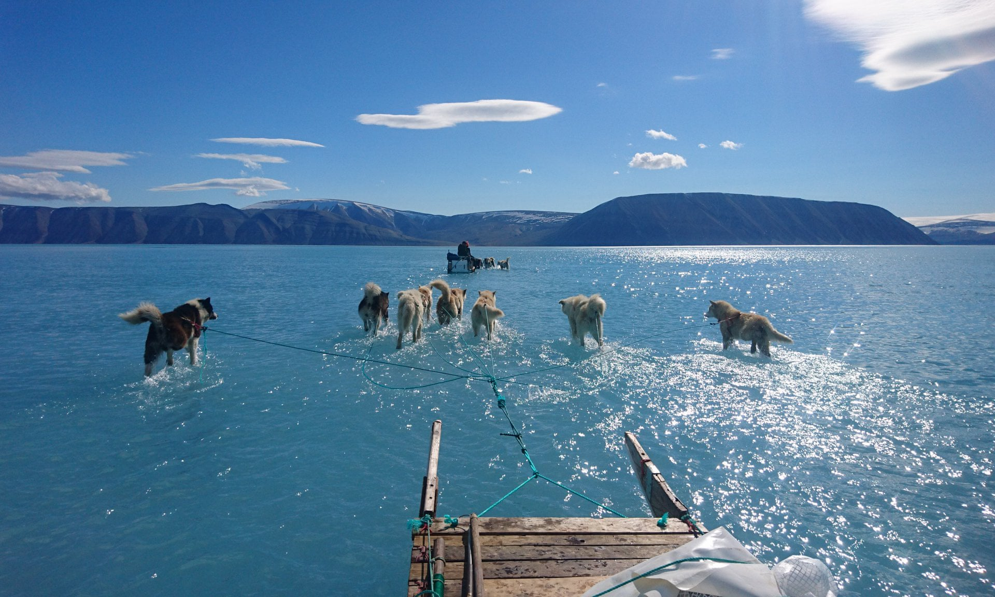
The Need for Transformation
Prof Chris Rapley CBE
University College London
@ChrisRapley3131

Slide 2
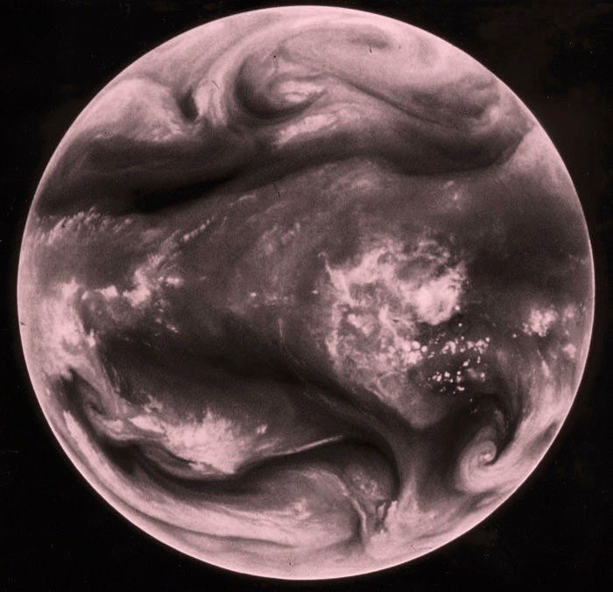
We have Upset the
Energy Balance of the Planet
Notes:
In period 2005-2010 solar minimum energy imbalance was 0.58+/-0.15 W/m2
Times 5.1*10**14 m2 gives 300*10**12W
Human energy generation (not consumption which is less due to efficiency losses) = 17.7*10**12W (TerraWatt)
Another source - 140,000 TWh/y - *8760h = 15.9TW
So ratio is 16-19 depending on figures adopted
Peter Stott verified on 8/11/18
According to Gregory Johnson, an oceanographer at NOAA, the rate of energy gained between 1971 and 2010 was roughly equal to the power required to run 140 billion 1,500-watt hair dryers over the same number of years. The rate has only increased in the past decade. 0.5-1 w/m2 (Ae = 510,072,000 = 5*10***8 km2 = 5*10**14 m2 so 1.4*10**11 x 1.5*10**3w = 0.42w/m2
Meteosat water vapor image, white indicates a very cold brightness temperature (radiation from a moist layer or cloud in the upper troposphere), and black indicates a warm brightness temperature (radiation from the Earth or a dry layer in the middle troposphere).
The "moist" and "dry" features seen on water vapor imagery result from various combinations of vertical motion, horizontal deformation and moisture advection within the middle and upper troposphere (generally the 4-12 km altitude range).

Slide 3
As the Energy Accumulates …
The world warms
Ice & snow melt
Sea levels rise
Ocean and Atmosphere circulation patterns change
Water cycle accelerates
Extreme Weather Events increase
Ecosystems respond
Food and Water supplies are affected
Infrastructure is damaged or requires upgrading
Economic and Political Stability are affected
People and Species are impacted

Slide 4
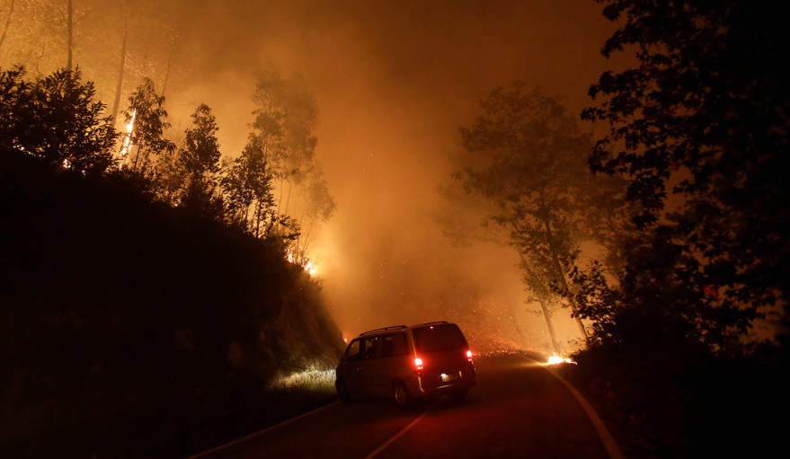
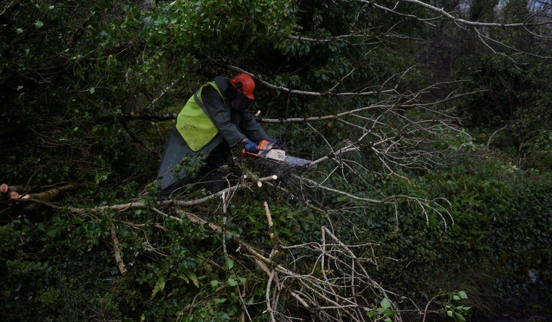
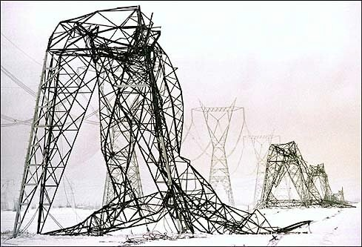
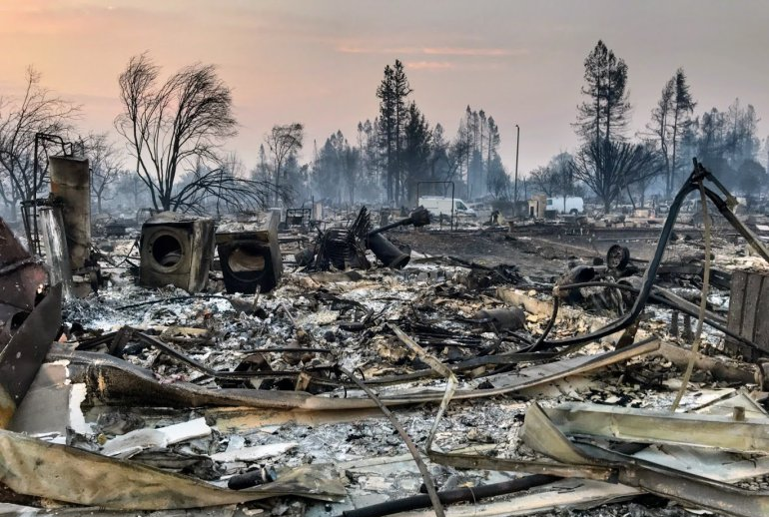
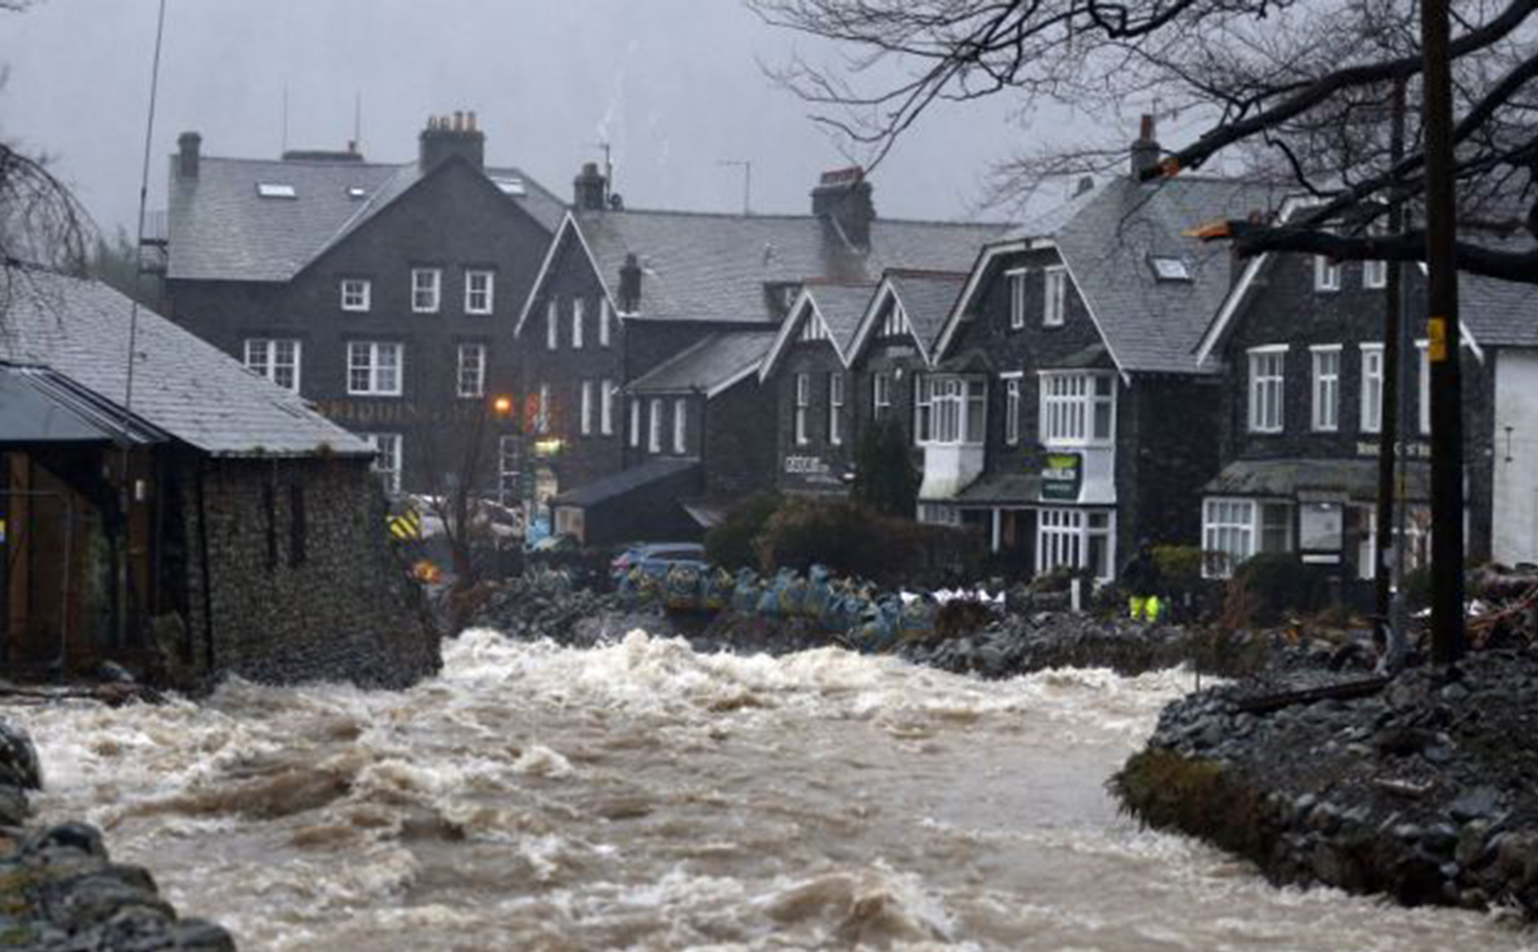
Imperfectly Adapted to the climate we inherited
Ill-prepared for the climate are provoking
Notes:
Portugal Oct 2017 / Eire (Ophelia Oct 2017) / Cumbria 2016 / Ca 2017
The Camp Fire -- the deadliest and most destructive wildfire in state history -- has destroyed about 9,800 homes and scorched 146,000 acres (an increase of 5,000 acres Friday). It is 50% contained.
In sep 2017 more than 1,200 people died across India, Bangladesh and Nepal as a result of flooding, with 40 million affected by the devastation. At least six people, including two toddlers, were among the victims in and around India’s financial capital.
The devastating floods have also destroyed or damaged 18,000 schools, meaning that about 1.8 million children cannot go to classes

Slide 5
Rising global temperatures, changing precipitation patterns, climbing sea levels, and more extreme weather events will intensify the challenges of global instability, hunger, poverty, and conflict.

Slide 6
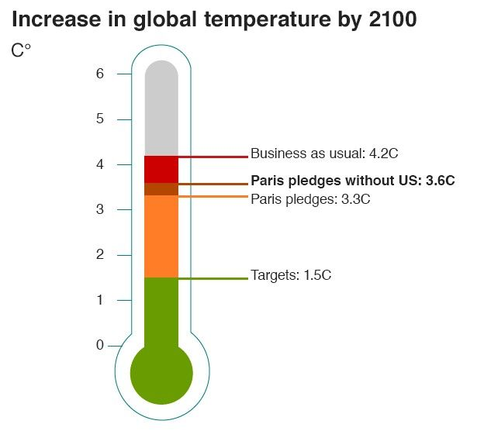

Slide 7
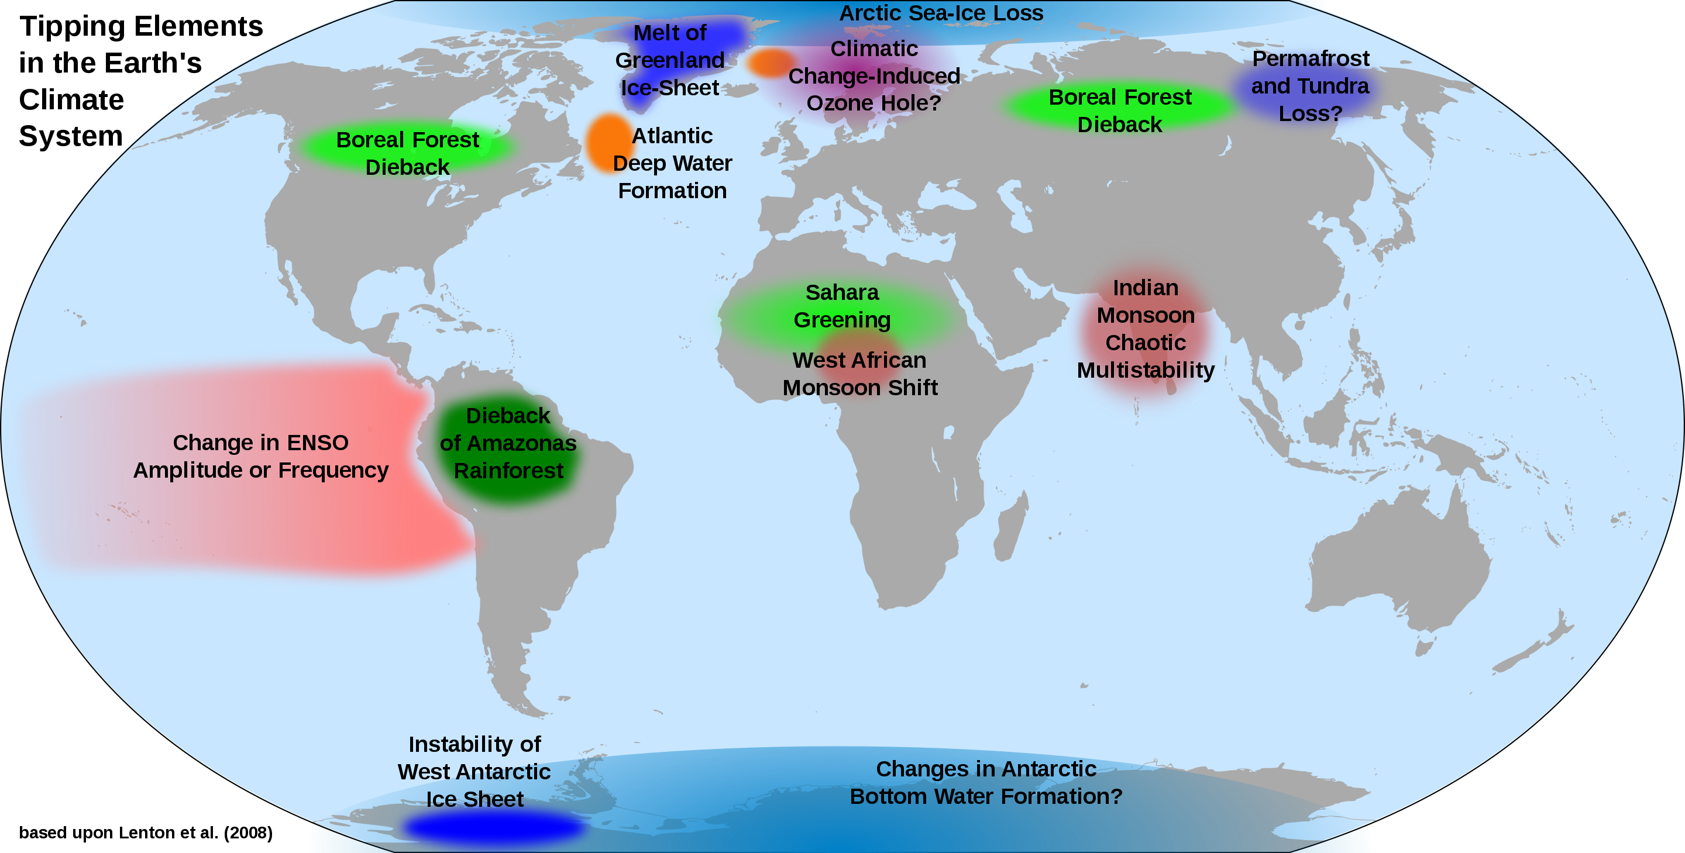
Planetary Tipping Points
Planetary Tipping Points

Slide 8
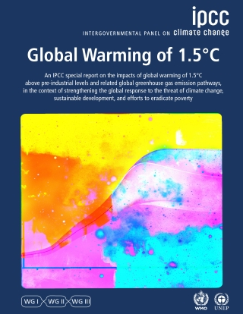
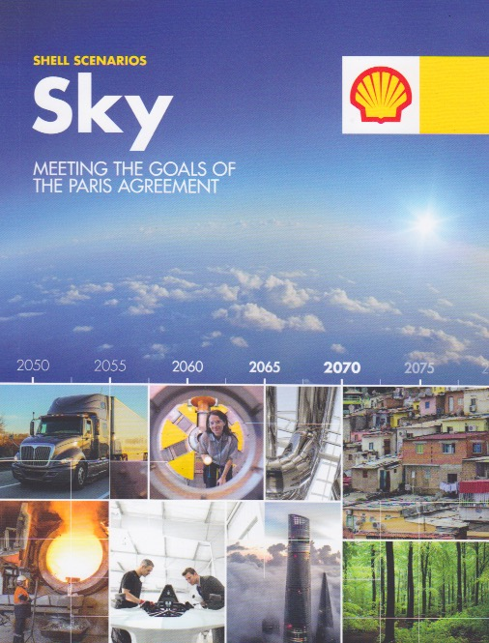
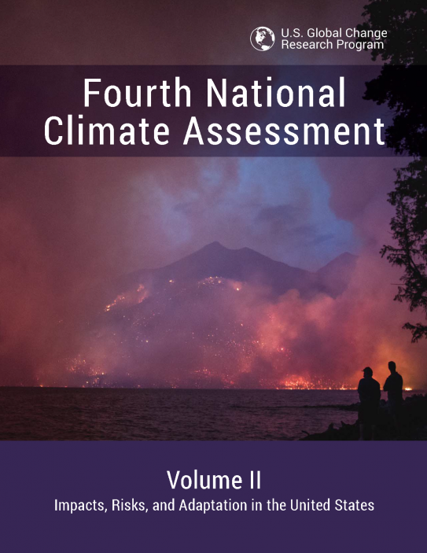
Running Out of Time
Notes:
Changes to the climate create risks to the natural, social and economic systems upon which societies depend. Extreme weather events such as heatwaves, droughts, intense precipitation and floods can cause humanitarian disasters, destabilise markets, damage critical infrastructure and harm food production. Although of a different nature, the slow onset risks from gradual changes in sea level and average temperatures are no less important and present existential threats to vulnerable populations such as those of low-lying small islands. As global temperatures continue to rise, so too do the risks of passing tipping points in the climate system that could trigger abrupt and disruptive changes that are very difficult to anticipate and adapt to

Slide 10
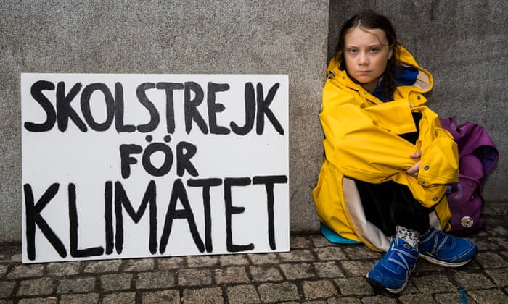

Slide 11
Climate Emergency

Slide 12
Tell the Truth
Act Now

Slide 13
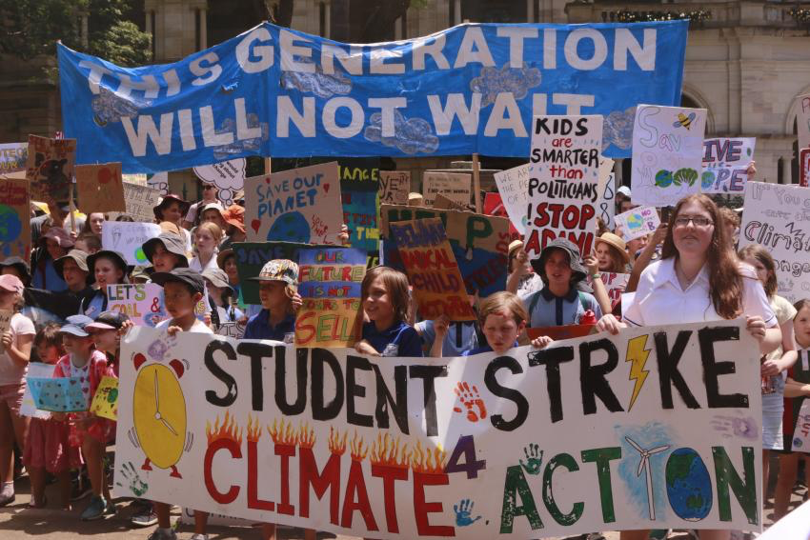
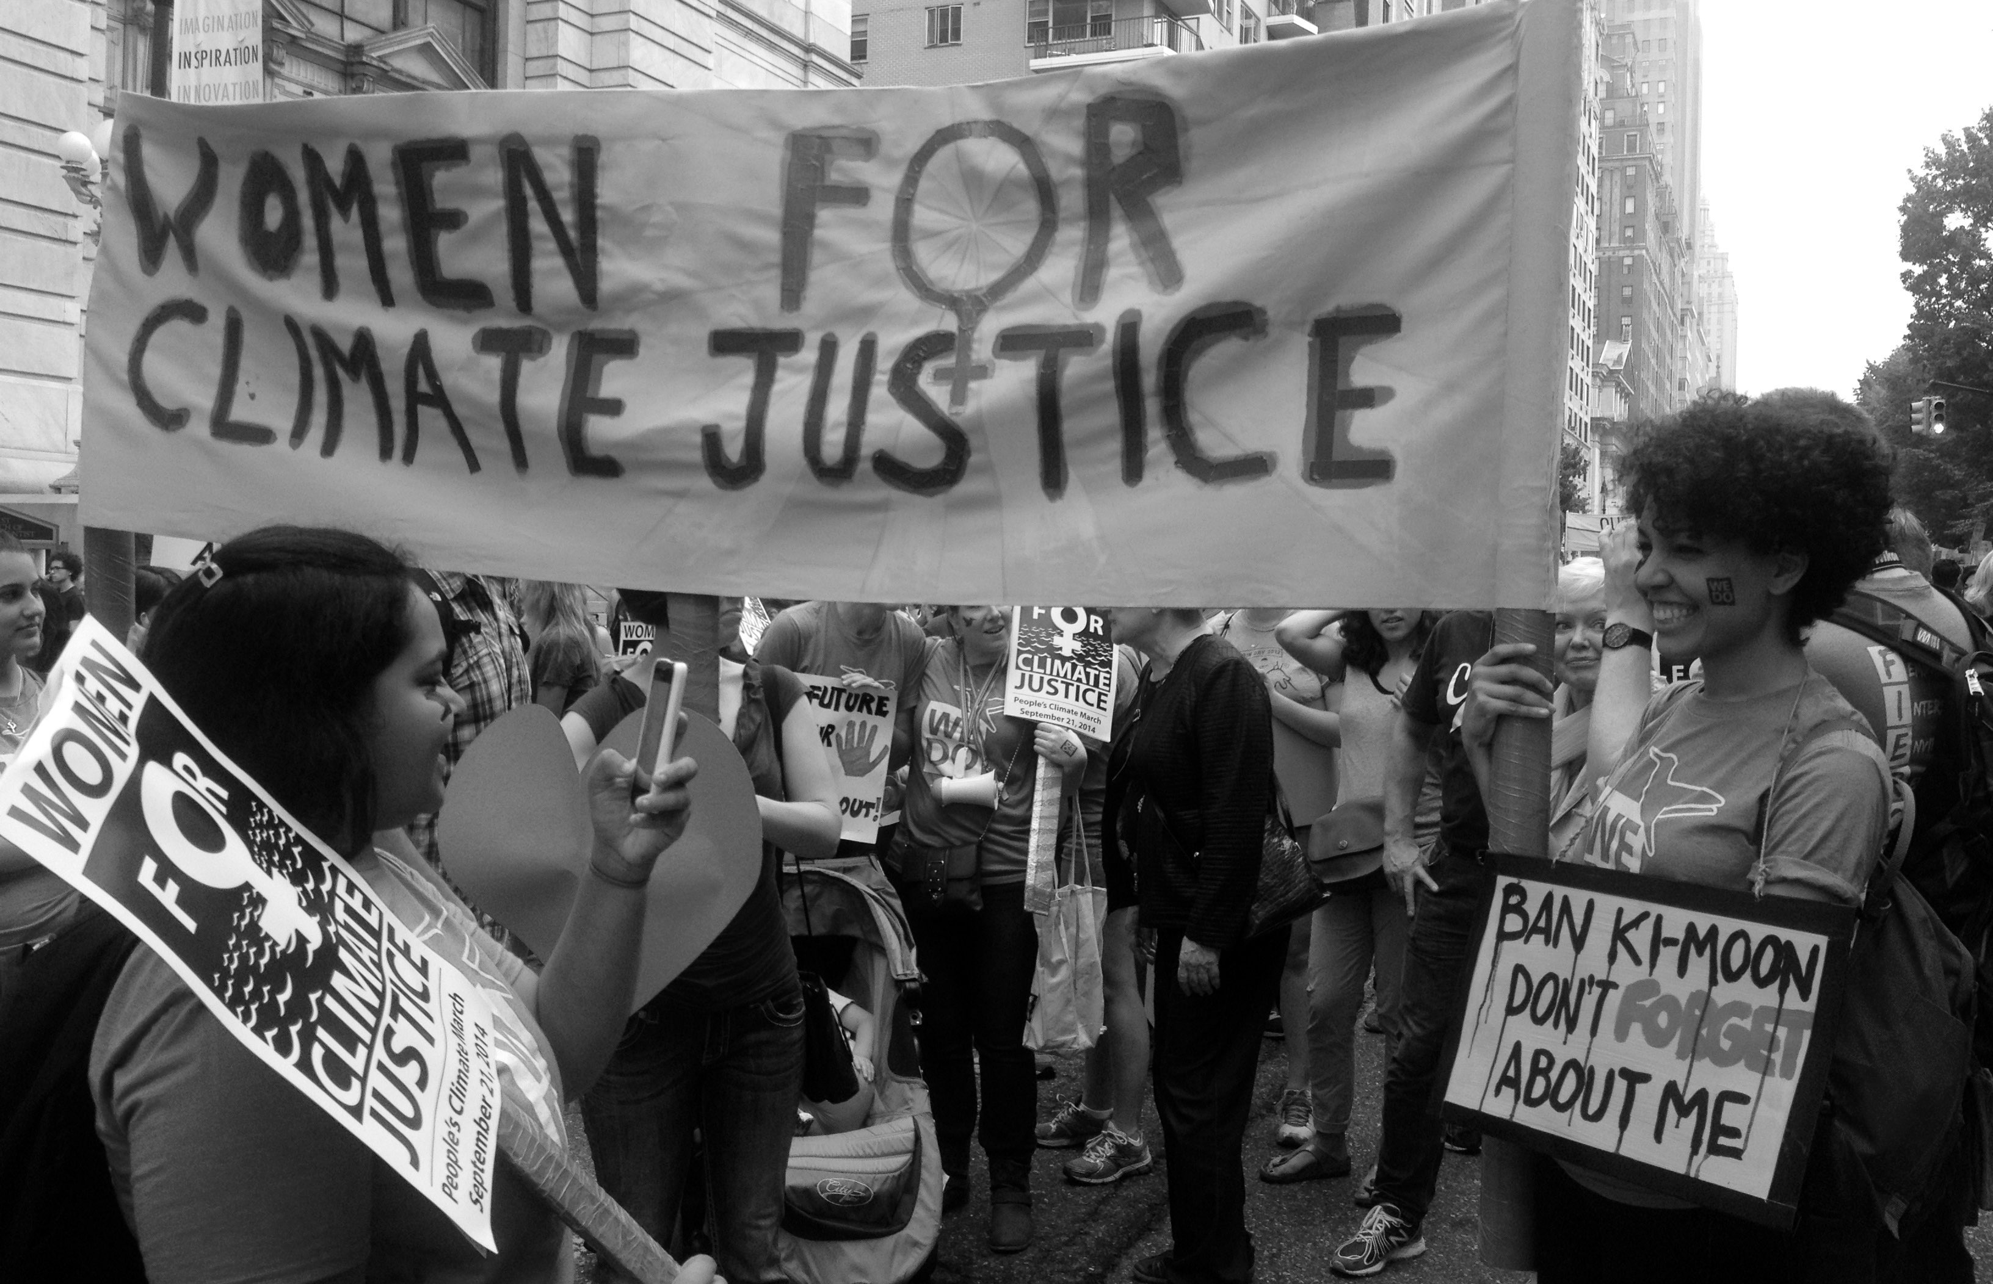
Abolish Fossil Fuels

Slide 15
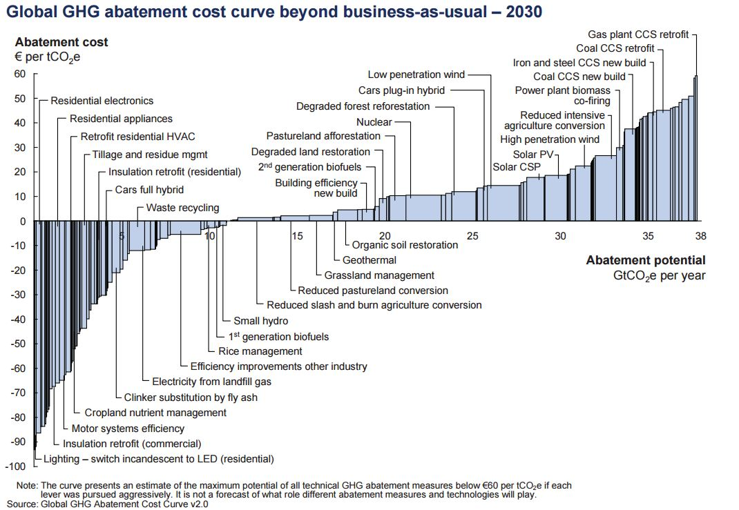

Slide 16
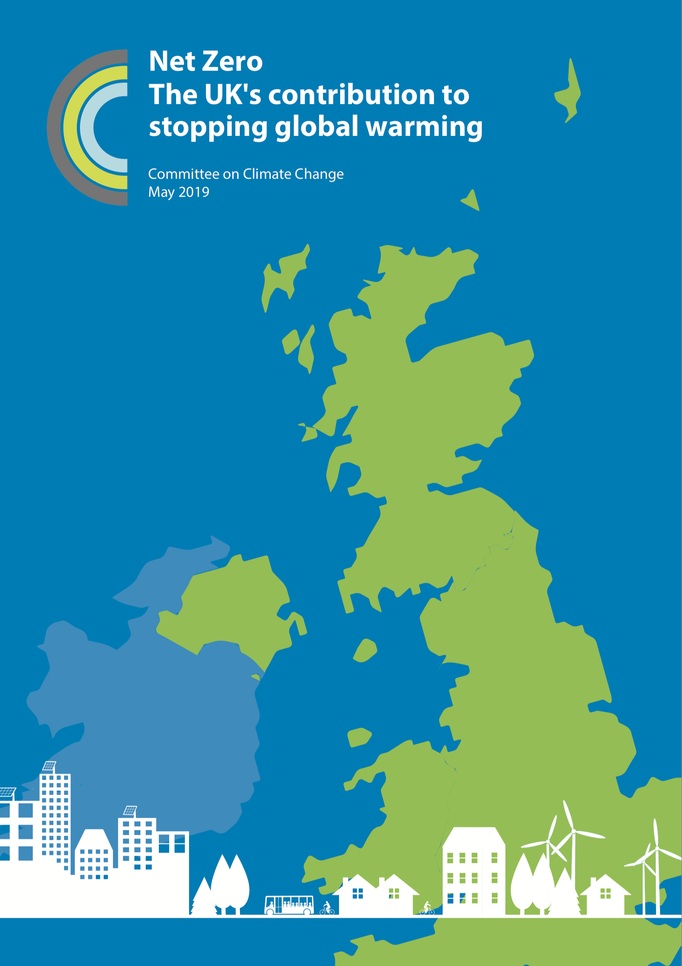
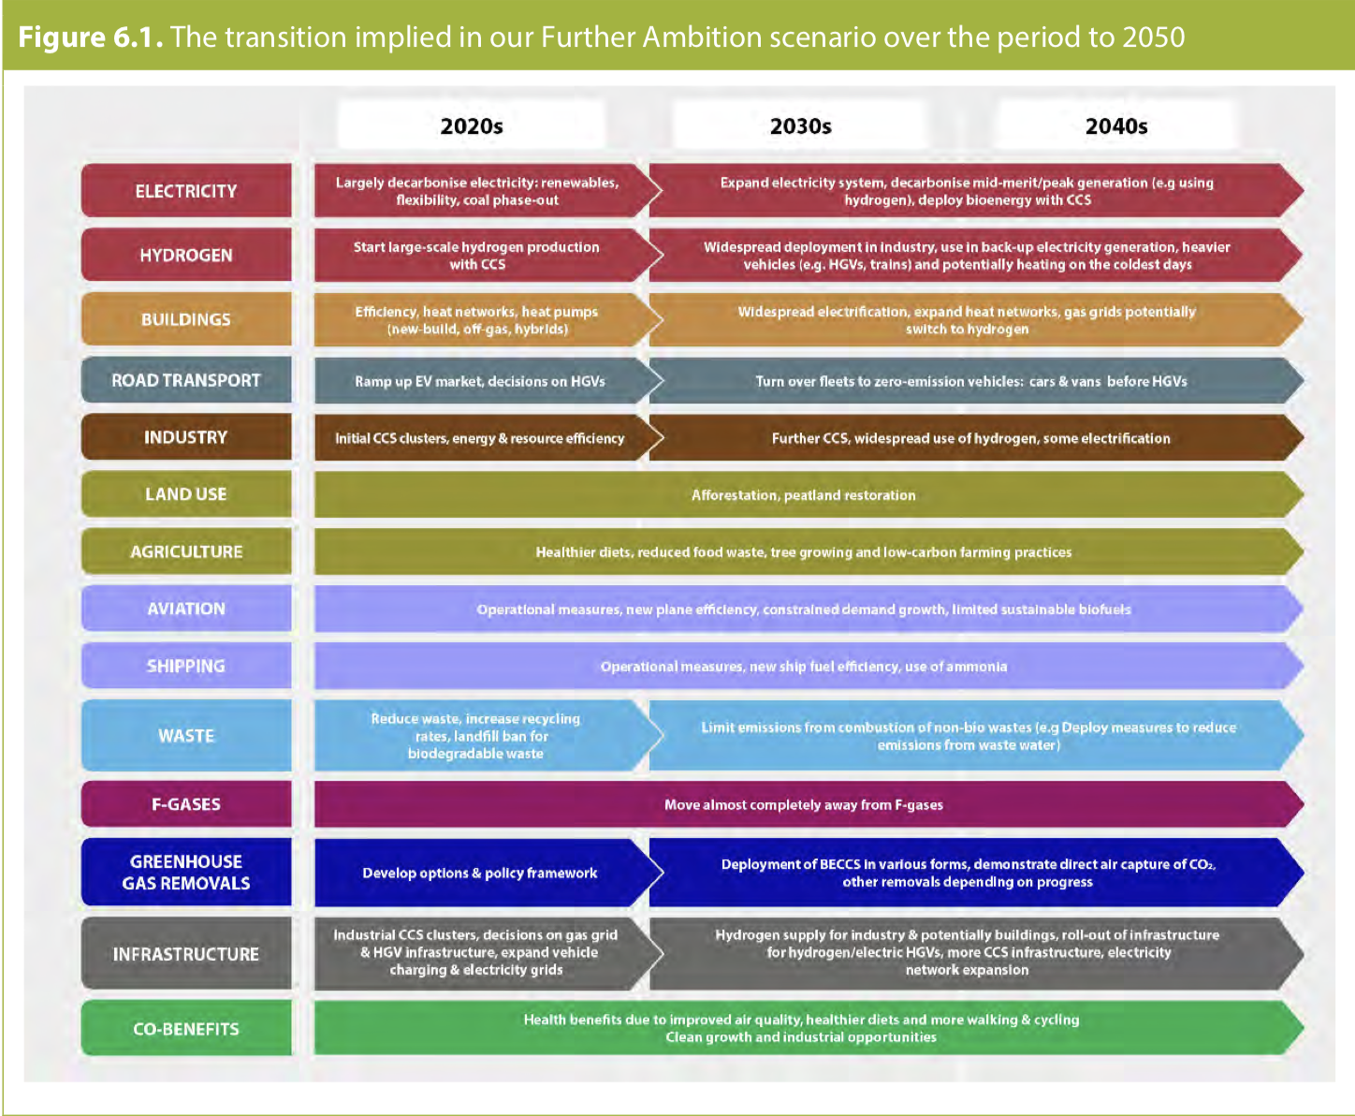

Slide 17
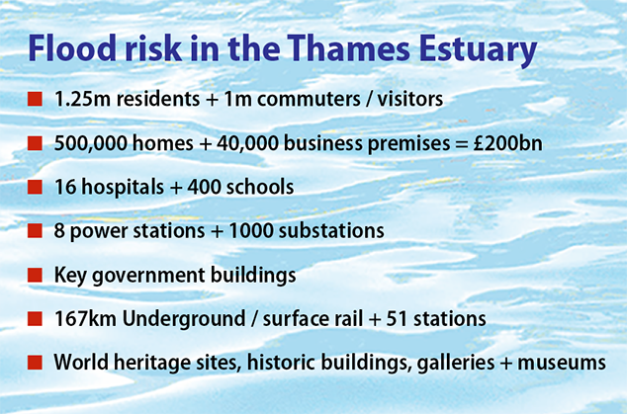
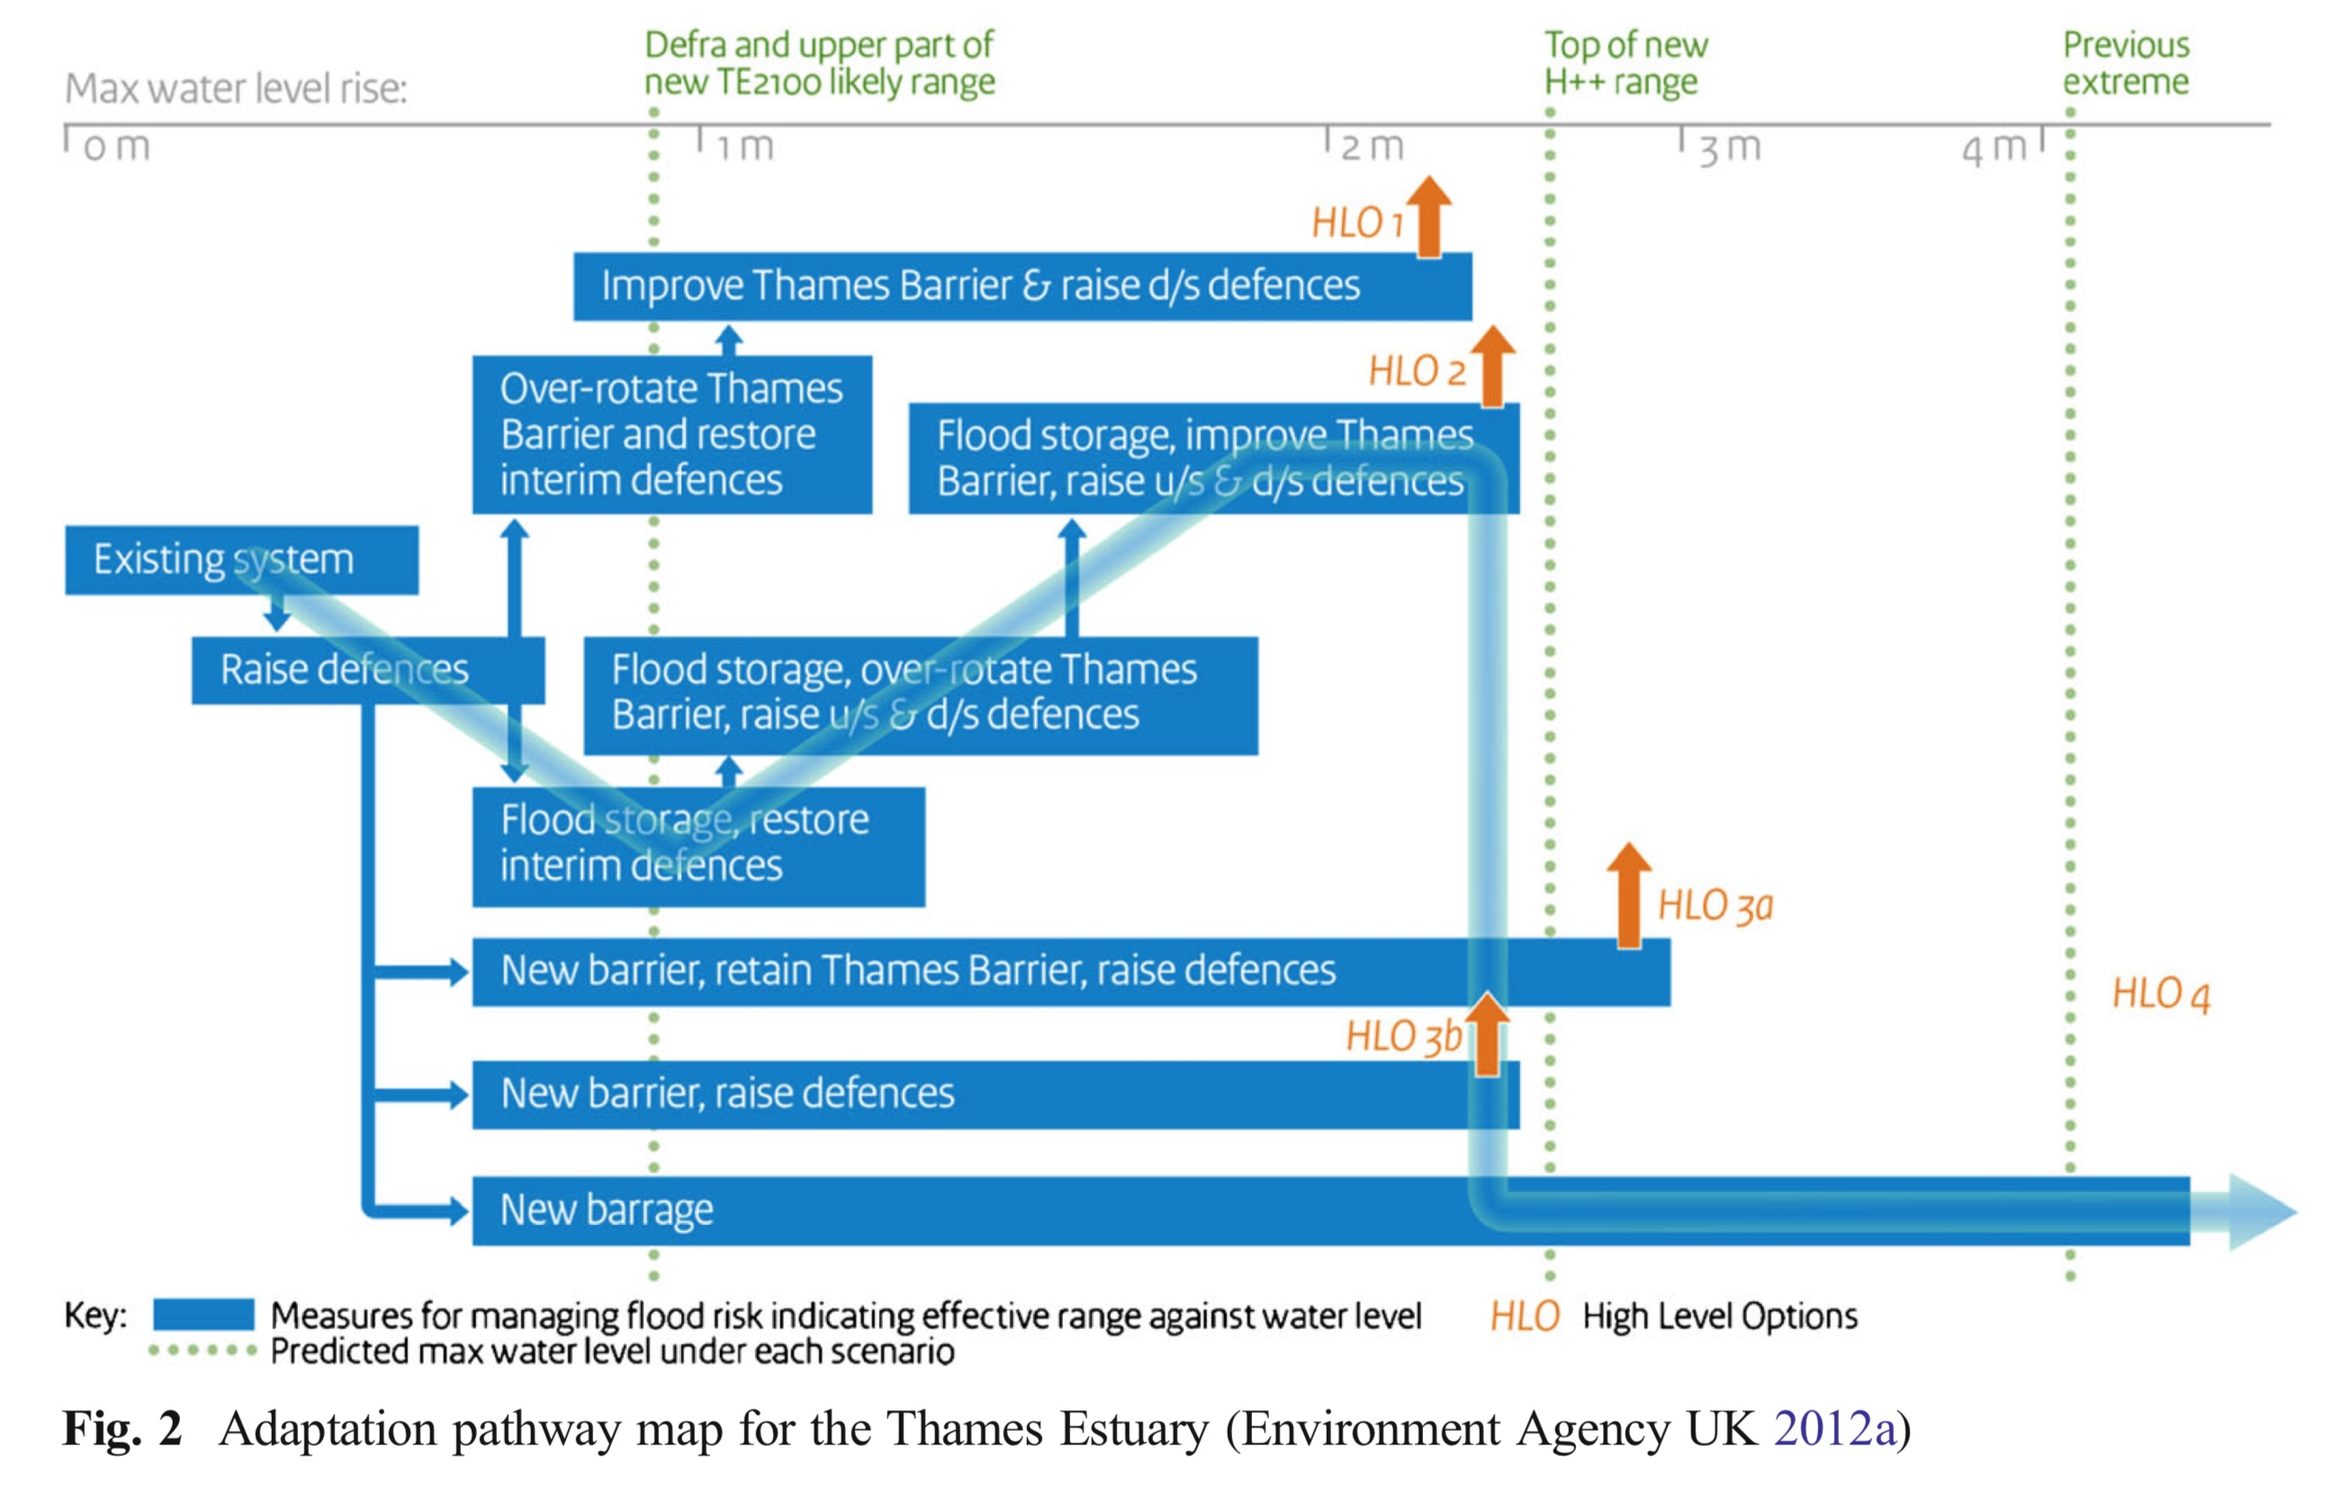
Thames Estuary 2100 Plan

