Slide 1
Dramatic Changes in UK Energy
over the last 50 years
…..
and now the next 10 years
Cutting through complexity – to tell the truth

Slide 2
How UK Energy Sources have changed since 1972
2.1
1.2
Zero &
Low
Carbon
Million tonnes of oil equivalent (Mtoe) per year
Million tonnes of oil equivalent (Mtoe) per year
What this tells us:
Natural gas has substantially replaced coal. A phenomenal change.
Renewables (wind/solar) has increased but it is still tiny. Lots more to do.
Bioenergy (biomass/biomethane, etc) is the large part of renewables. But is combusted. Is that really green?
Population has increased by 20% and total energy sources used have reduced by 5%. ie. Improved efficiencies.
Fossil fuels (natural gas, coal, petroleum, oil) still make up 79% of total energy sources used in 2019.
UK is very dependent upon imports for its total energy sources (see page 8).

Slide 3
How UK Energy Consumption has changed since 1972
0.7
Million tonnes of oil equivalent (Mtoe) per year
Million tonnes of oil equivalent (Mtoe) per year
What this tells us:
Transport fuels have increased significantly and are now a primary air pollution and emissions problem.
Industry has depleted dramatically. In effect UK has outsourced manufacturing to other countries and then treats this as a scope 3 emission (ie. a consumption-based emission), which is not counted for net-zero targets.
Conversion losses have increased (mainly due to increased use of electricity; gas/nuclear/grid losses)
Primary fuel production/extraction (mainly coal) in 1972 required significant energy.
Population has grown by 20% and domestic electr/heating has increased 14%. So little efficiency improvement.

Slide 4
UK Government Commitment 1 (Nov 2020):
Addition 30GW of Offshore Wind Electricity Capacity by 2030
UK Onshore wind in 2020: 13.6 GW capacity (incl. projects under construction) typical load factor: 26%
UK Offshore wind in 2020: 10.4 GW capacity (incl. projects under construction) typical load factor: 38%
Total generation in 2019: 65,657 GWh per annum. Source: RenewableUK; UKWED Database.
Load factor is the % of the full rated capacity of the wind turbines that is turned into energy per year.
22.6 Mtoe additional electricity
(million tonnes of oil equivalent)
ie. Displacing around 14% of the fossil fuel
Energy used for transportation and Natural Gas.
Albeit source-to-wheel efficiency of Electric
Vehicles (EV) is much better then well-to-wheel
efficiency of internal combustion engine vehicles.

Slide 5
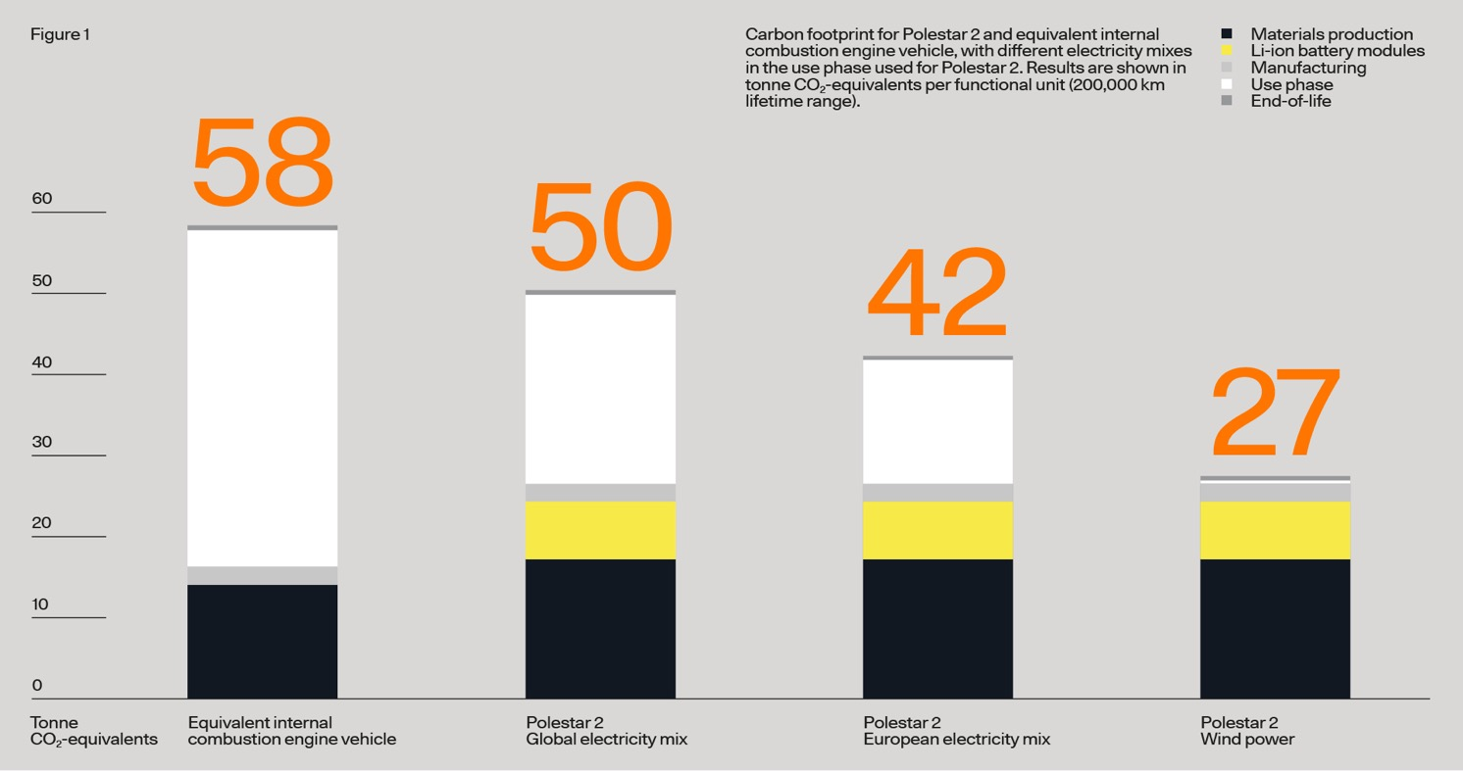
Electric Vehicles are not Zero Carbon (Commitment 4)
Only upto 53%
lower carbon even
when charged with
100% renewable
electricity.
tonnes CO₂
equivalent
End-of-life
Driving use phase
Manufacturing
Batteries
Materials
Conventional
Petrol Vehicle
(medium size; good efficiency)
EV charged
with global
grid mix of
electricity
EV charged
with EU
grid mix of
electricity
EV charged
with 100%
renewable
electricity
Source:
Polestar; 2020
(representative of typical
medium sized EV)
13% less CO₂
27% less CO₂
53% less CO₂

Slide 6
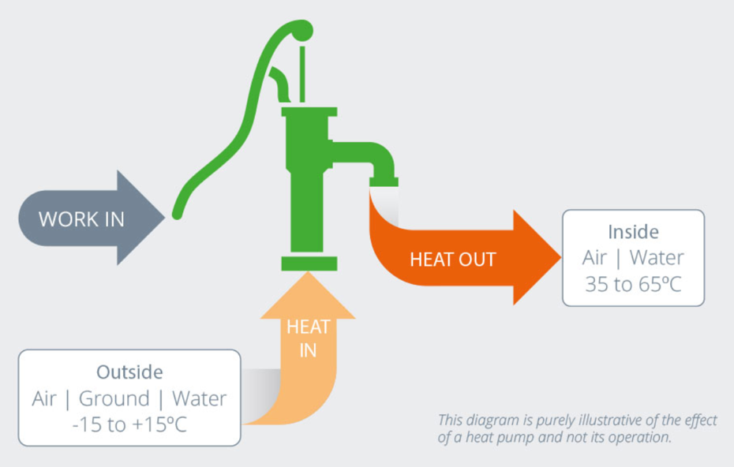
UK Government Commitment 7 (Nov 2020) :
600,000 heat pumps per year to 2028
Heat pumps need 100% green electricity to power them and need properties to be highly insulated, to approach
zero carbon for the heating of properties.
Average medium sized property uses 12,800 kWh of heat. Let’s assume better insulation reduces that to 8,900 kWh
600,000 heat pumps per year to 2028 is just 15% of
UK household properties.
Typical air source heat pump needs 1kWh of electricity to make 3.2 kWh of heating output.
So will require 12,000 GWh of renewable electricity
to power the 600,000 per year heat pumps –
That is another 1 Mtoe (Million tonnes of oil equivalent) of renewable electricity generation needed.
electricity
1 unit
Typically
3.2 units

Slide 7
CONCLUSIONS
Further significant change to the UK’s energy system is still needed
But… technology alone will not lead to ‘net zero’ carbon
UK Government policy is fixated on technology to solve the problem
All this new technology needs an expansion well beyond another 30GW of offshore wind energy Significantly more localised renewables is needed (ie. less losses)
Significantly enhanced thermal insulation standards are needed now, not after year 2025, in order to support the heat pump commitment
Our consumption-based emissions are significant and need a major change in the way we consume and the way we live
Electric Vehicles do not change carbon emissions to zero.

Slide 8
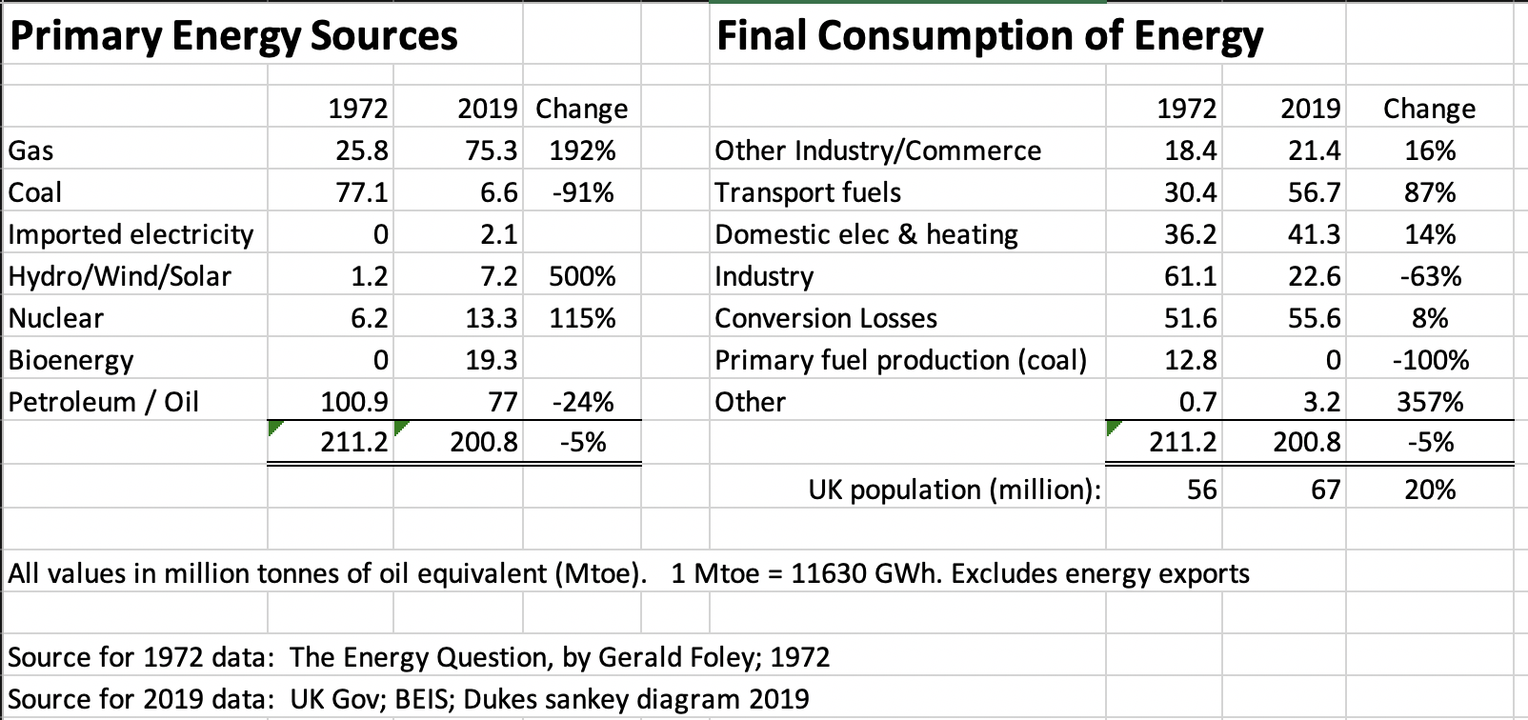
Data:
!
!
(Sankey diagram)
Electricity Production in 1972 was 17.7 Mtoe versus in 2019 was 29.6 Mtoe. ie. has already increased 67%.
In 2019: 54% of natural gas is imported into UK. 75% of coal is imported into UK.
62% of petroleum/oil is imported into UK. 28% of bioenergy is imported (mainly biomass for combustion).

Slide 9
UK
Data: UK Energy Flow Chart 2019
(Million tonnes of oil equivalent)
Primary

